Slide 1
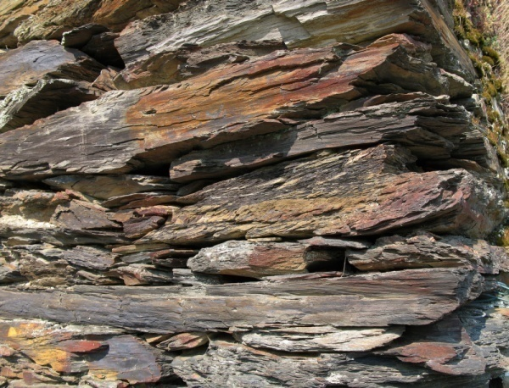

Shale Gas Potential in Germany – Pre-Exploration Estimates
Brussels, 17th Sept. 2015
Hans-Joachim Kümpel,
Federal Institute for Geosciences and Natural Resources (BGR),
Hannover, Germany

Slide 2
    Rationale for Shale Gas Issue
    Assessment of Shale Gas Potential
    Skepticism in the Public

Slide 3
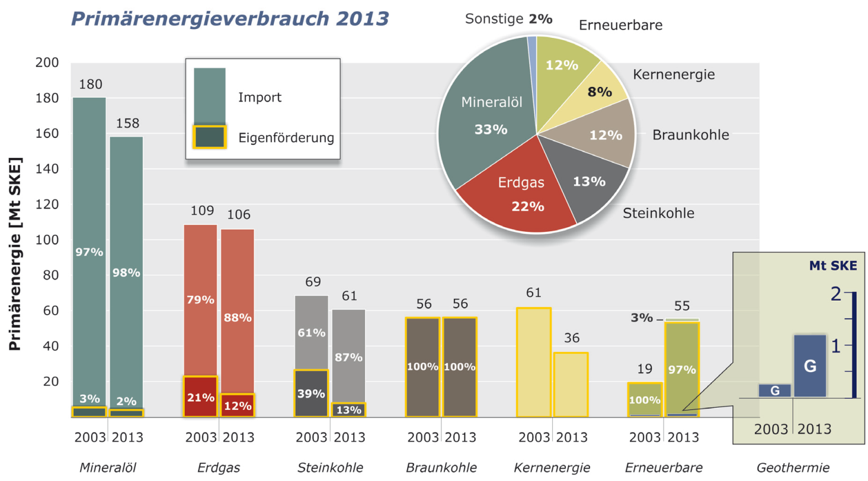
Germany‘s Dependance on the Import of Energy Resources
- 2003 and 2013 -
Primary Energy Consumption 2013
Others 2 %
Renewables
Import
Domestic
Nuclear Fuels
Oil
33 %
Lignite
Natural Gas
22 %
  55 % of PEC
Hard Coal
Primary Energy [Mt SKE]
Oil
Natural Gas
Hard Coal
Lignite
Nuclear Fuels
Renewables
Geothermics

Slide 4
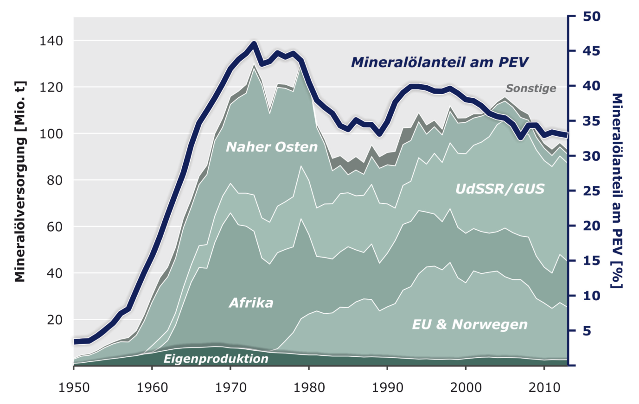
Germany‘s Oil Supply 1960 - 2013
Oil Share of PEC
Others
Near East
Oil Suply [Mio t]
USSR /GUS
Oil Share of PEC [%]
  ca. 33 % of German energy requirement;
  5 % decrease since 2000
Africa
EU & Norway
Domestic Production
Notes:
2000: ca. 38% des PEV
2013: ca. 33% des PEV
bezogen auf PEV ist das 5% weniger seit 2000
bezogen auf 38% ist das Abnahme um 16,7% !

Slide 5
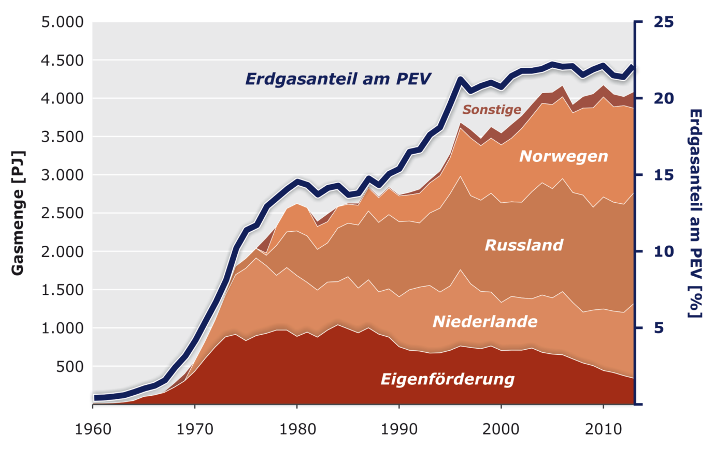
Germany‘s Natural Gas Supply 1960 - 2013
  ca. 22 % of Germany‘s energy requirement; hardly changed since 20 years
Natural Gas Share of PEC
  Almost 50 % for private households (heating, warm water)
Others
Norway
Natural Gas Quantity [PJ]
Natural Gas Share of PEC [%]
Russia
The Netherlands
Domestic Production
?
Notes:
PEC – Primary Energy Consumption
Germany imports almost 87 % of their natural gas requirements. Biggest supplier is Russia, followed by Norway and the Netherland. Domestic production has sunken to only 13 % of PEC. Within the last 10 years domestic production has halved.
Natural gas covers almost ¼ of the total German energy requirement (since ca. 2000).
I.e.: ca. 47 % heating and warm water, 37 % industry, 15.5 % electricity and district heating, 0.5 % traffic (figures as to DIE ZEIT, 21.08.2014, S.29 GRAFIK, Thema Erdgas, Dirk Asendorpf)

Slide 6
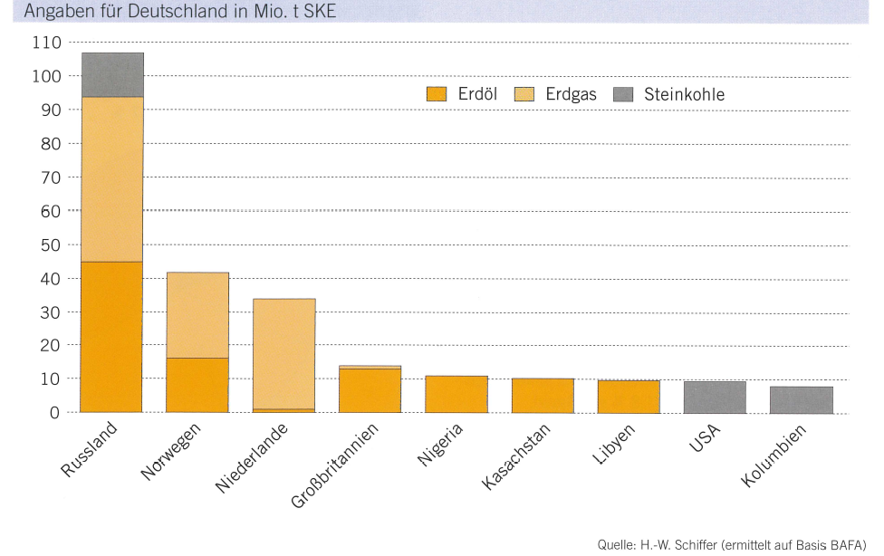
Germany‘s Imports of Energy Resources (2013)
Figures for Germany in Mio t SKE
Oil Natural Gas Hard Coal
Russia
Norway
The Netherlands
Great Britain
Nigeria
Kazachstan
Libya
USA
Columbia
as to: World Energy Council Germany, e.V., 2014
Quelle: H.-W. Schiffer (ermittelt auf Basis BAFA)
Notes:
Figures for 2014: [http://www.weser-kurier.de/startseite_artikel,-Weniger-Erdgas-und-Erdoel-aus-Deutschland-_arid,1097762.html ]
Lower Saxony‘s revenues due to lower royalties decreased by almost 200 Mio €
Der Artikel wurde zur Merkliste hinzugefügt.
Die Merkliste finden Sie oben links auf der Seite.
Less oil and natural gas of Germany
Joachim Göres 10.04.2015 0 Kommentare
Production of natural gas and oil decreased in Germany last year. WEG in Hannover informed accordingly on Thursday. Following this, last year the domestic natural gas production decreased to 9.1 Mrd. cubic metres (2013: 9,7 Mrd.). Thus the natural gas produced in Germany contributed with 12 % to the domestic consumption. Most important supplier of natural gas remains Russia with a share of 37 %, followed by The Netherlands (25 %) and Norway (22 %).
By the royalties the producers have to pay, mainly the state of Lower Saxony benefitted in 2014 with revenues of 474 Mio €. However, one year earlier this sum had been considerably higher with 663 Mio €. The revenues are expected to decrease further as the state announced a reduction of royalties. 96 % of the natural gas is produced in Lower Saxony. The largest fields are Völkersen (Landkreis Verden), Goldenstedt-Oythe (LK Vechta), Bötersen, Söhlingen, Hemsbünde (all LK Rotenburg) and Siedenburg (LK Diepholz). Major part of the oil comes off Mittelplate and Dieksand in Schleswig-Holstein, the two largest German oil fields in the North Sea where 55 % of the German oil originate. In 2015 Schleswig-Holstein collected about 115 Mio € of royalties.

Slide 7
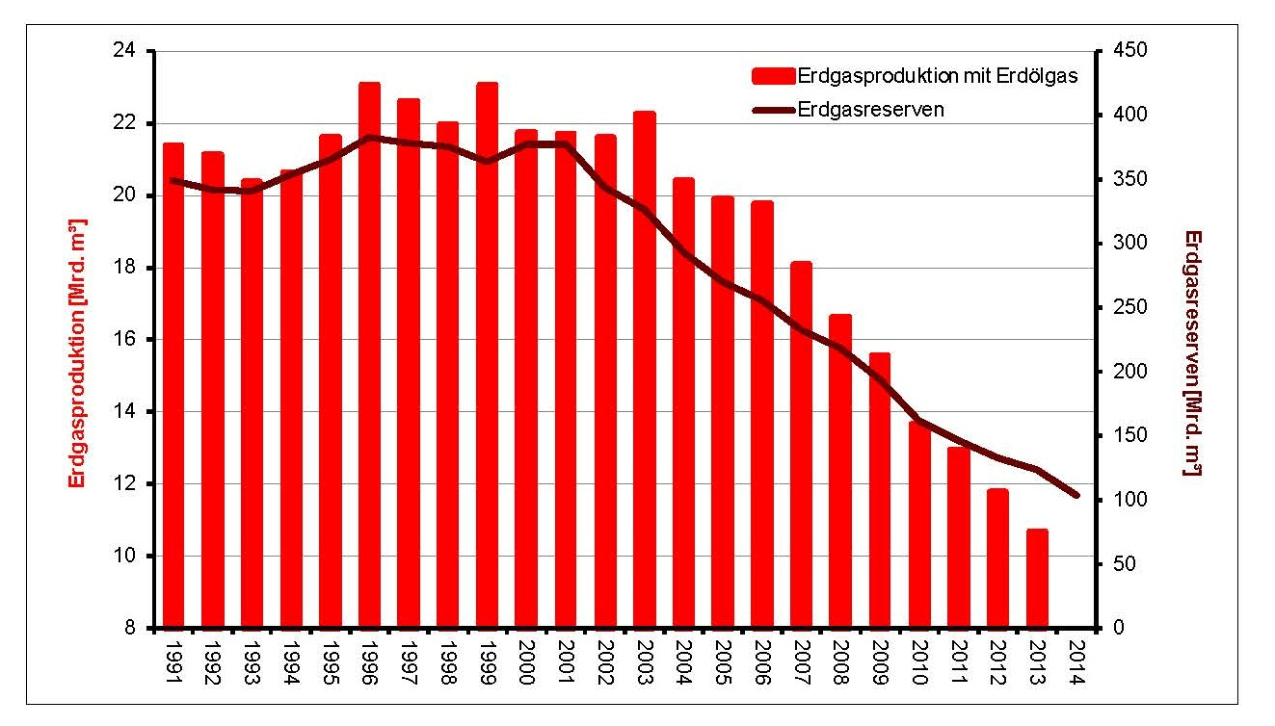

Development of domestic gas production (crude gas) and gas reserves since 1991
Natural gas production with oil gas
Natural gas reserves
Natural Gas Producton [Billion m³]
Natural Gas Reserves [Billion m³]
Germany‘s Natural Gas Production and Reserves (as to 01.01.2014)
Notes:
Zahlen für 2014: [ http://www.noz.de/deutschland-welt/wirtschaft/artikel/564081/weniger-erdgas-und-erdol-aus-deutschland ]
Production of natural gas and oil decreased in Germany last year. WEG in Hannover informed accordingly on Thursday. Following this, last year the domestic natural gas production decreased to 9.1 Mrd. cubic metres (2013: 9,7 Mrd.). Thus the natural gas produced in Germany contributed with 12 % to the domestic consumption. With a quantity of 2.4 Mio to also the oil production decreased (2013: 2.6 Mio). This quantity represents about 3 % of the German consumption. By the royalties the producers have to pay, mainly the state of Lower Saxony benefitted in 2014 with revenues of 474 Mio €. However, one year earlier this sum had been considerably higher with 663 Mio €.
96 % of the natural gas is produced in Lower Saxony. The largest fields are Völkersen (Landkreis Verden), Goldenstedt-Oythe (LK Vechta), Bötersen, Söhlingen, Hemsbünde (all LK Rotenburg) and Siedenburg (LK Diepholz). With oil, Lower Saxony‘s share is at 34 %. The largest deposits are west of the river Ems in Emlichheim and Rühlermoor -Valendis. Most of the German oil is stored in the Erdölwerk Holstein in Heide, followed by the oil-refinery Emsland in Lingen.
Ca. 10,000 employees are working with the WEG-members, numbering i.e. GDF Suez E&P Deutschland in Lingen, Geo Service in Georgsdorf as well as Bentec und die KCA Deutac Drilling in Bad Bentheim. For the first time for 10 years, in 2014 the number of employees in the sector decreased. Beginning of this year the situation got worse by short-time working and redundancies within the supplying industry.
Considering low energy prices there is less investment in drillings, moreover the Russia-boycot for the suppliers shows a negative effect. According to WEG also delayed permissions for exploiting new deposits would effect negative consequences.

Slide 8
    Rationale for Shale Gas Issue
    Assessment of Shale Gas Potential
    Skepticism in the Public

Slide 9
Natural Gas off Clay Rock
1. Report June 2012
Shale Gas Potential in Germany
Projekt NIKO*
Abschätzung des Erdgaspotenzials aus
dichten Tongesteinen (Schiefergas) in
Deutschland
www.bgr.bund.de
* unconventional HCs
Screening
Formations
Regions
Literature
Former studies (e.g. SPBA-Atlas)
GIS
Formation-parameter
Facies
Depth
Thickness
Assessment
Volumetric (Gas-in-Place)
Monte-Carlo-Simulation

Slide 10
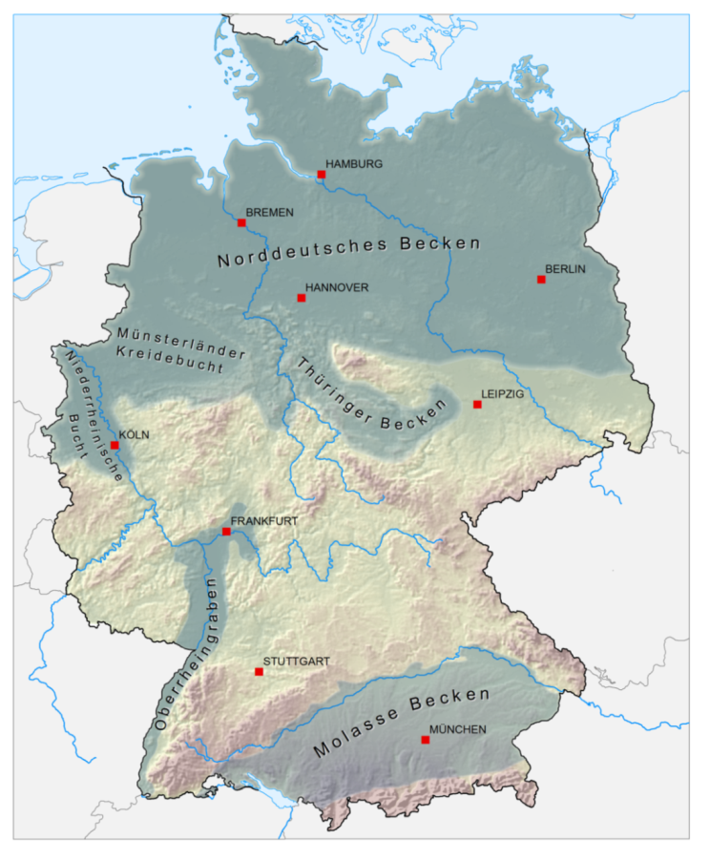
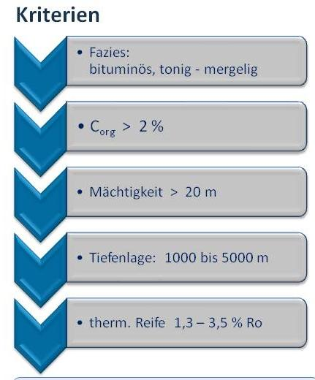
Potential Shale Gas Provinces in Germany
Criteria
Facies:
bituminous, clayey - marly
C_{org} > 2 %
Thickness > 20 m
Depth: 1000 to 5000 m
Thermal maturity 1.3 – 3.5 % Ro
Potential for Shale Gas
Notes:
Eozän / Oligozän
Blättertone (mittlere Unterkreide)
Wealden (Grenze Jura / Kreide)
Opalinuston (Unterjura)
Posidonienschiefer (Unterjura)
Zechstein (Stinkkalke)
Permo-Karbon Süddeutschlands
Alaun- und Kulm-/Kohlenkalkschiefer (Unterkarbon)
Wissenbachschiefer (Mitteldevon)
Graptolitenschiefer (Silur / Devon)
Approach
Checking data available
Definition of target horizons and priority areas
Charakterizing of clay rocks (Geochemics, Clay mineralogy, Sedimentology, Stratigraphy)
Estimation of resources
volumetric approach
Corg > 2%, hohe HI-Werte; plus:
HI – Hydrogen Index
HI is an abbreviation for Hydrogen Index usual in organid geochemics/oil geology.
It is in proportion to the hydrogen content of Kerogens, the organic material contained in the rock to develop oil and gas. The greater the HI, the greater the potential of developing hydrocarbon. High HI-values therefore indicate „good“ oil-bedrock.
In our estimation of shale gas potential, HI is regarded as a general, qualitative criterion in selecting the bedrock to be surveyed.
Details:
The HI of a rock is defined with the aid of the „Rock-Eval-Analyse“ – a Pyrolyse-process. This is a standard process of hydrocarbon-industry.
HI = S2 (mg hydrocarbons) / TOC (g organic carbon) [mg HC/g C_{org}]
S2 indicates the quantity of hydrocarbon released from the sample during the Rock Eval-Pyrolyse. This corresponds with the hydrocarbons still to be released from the respective rock.
Statements made by the aid of HI, are to be compated with those of elementary analytics (relation of hydrogen/carbon).
It permits e.g. a classification of Kerogen-types depending on which are gas/oil occurence. The greater the HI (the more hydrogen per carbon), the more oil can develop. High HI-values depend on the resp. Kerogen-type and the thermal maturity. Values of >400 for type 2 Kerogens for instance are high. For graphic evaluation pseudo-van Krevelen-diagrams are used (HI versus OI; Oxygen Index). In the original van Krevelen-Diagrams H/C and H/O relations are shown.

Slide 11
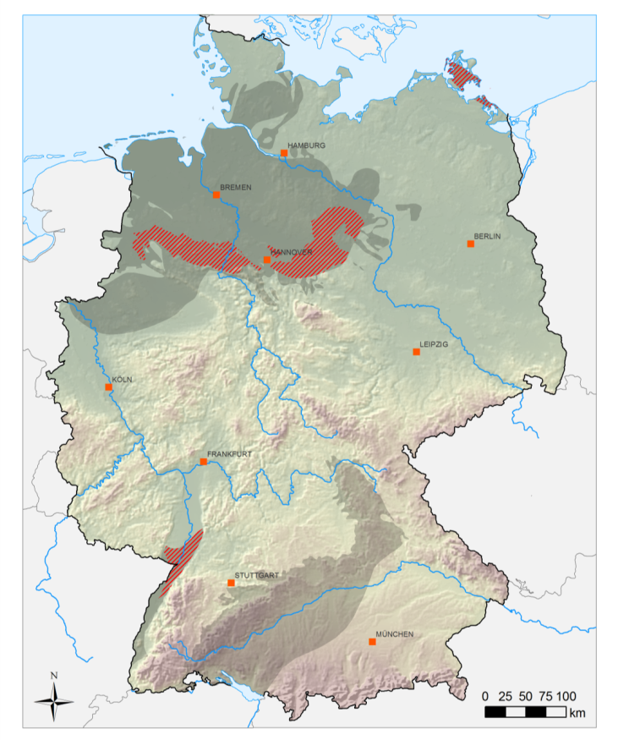
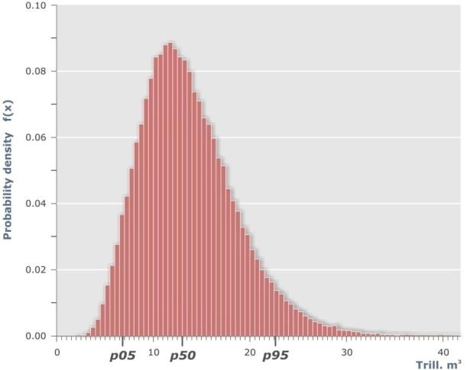
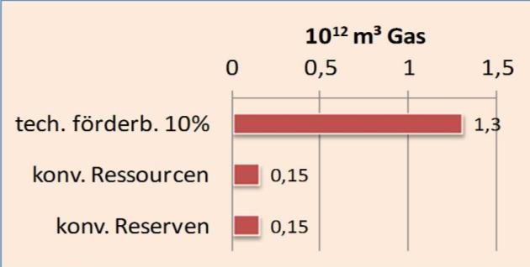
Germany’s Shale Gas Potential
First Assessment 2011/2012
Gas-in-Place
Minim. 7
Median 13
Maxim. 23
x 10¹² m³
Geologic Formations:
Cretaceous (Wealden)
Jurassic (Posid. Shale)
Lower Carbon (Alum Shale)
10¹² m³ = 1.000 Billion m³
techn. recoverbale 10 %
conv. Resources
conv. Reserves
X
0,09 (as of 1.1.2015)
Notes:
Formations: Creataceous Wealden; Jurassic Posidonia; Lower Carboniferous „Alaun-Shales“
Sehr lückenhafte Datenlage im NW, vergleichsweise gute Datenlage im NE
-
tcm : engl. trillion cubic meter = deutsch Billionen Kubikmeter
10^12 cubic meter
1 tcm ~ 35 tcf
13 tcm ~ 459 tcf

Slide 12
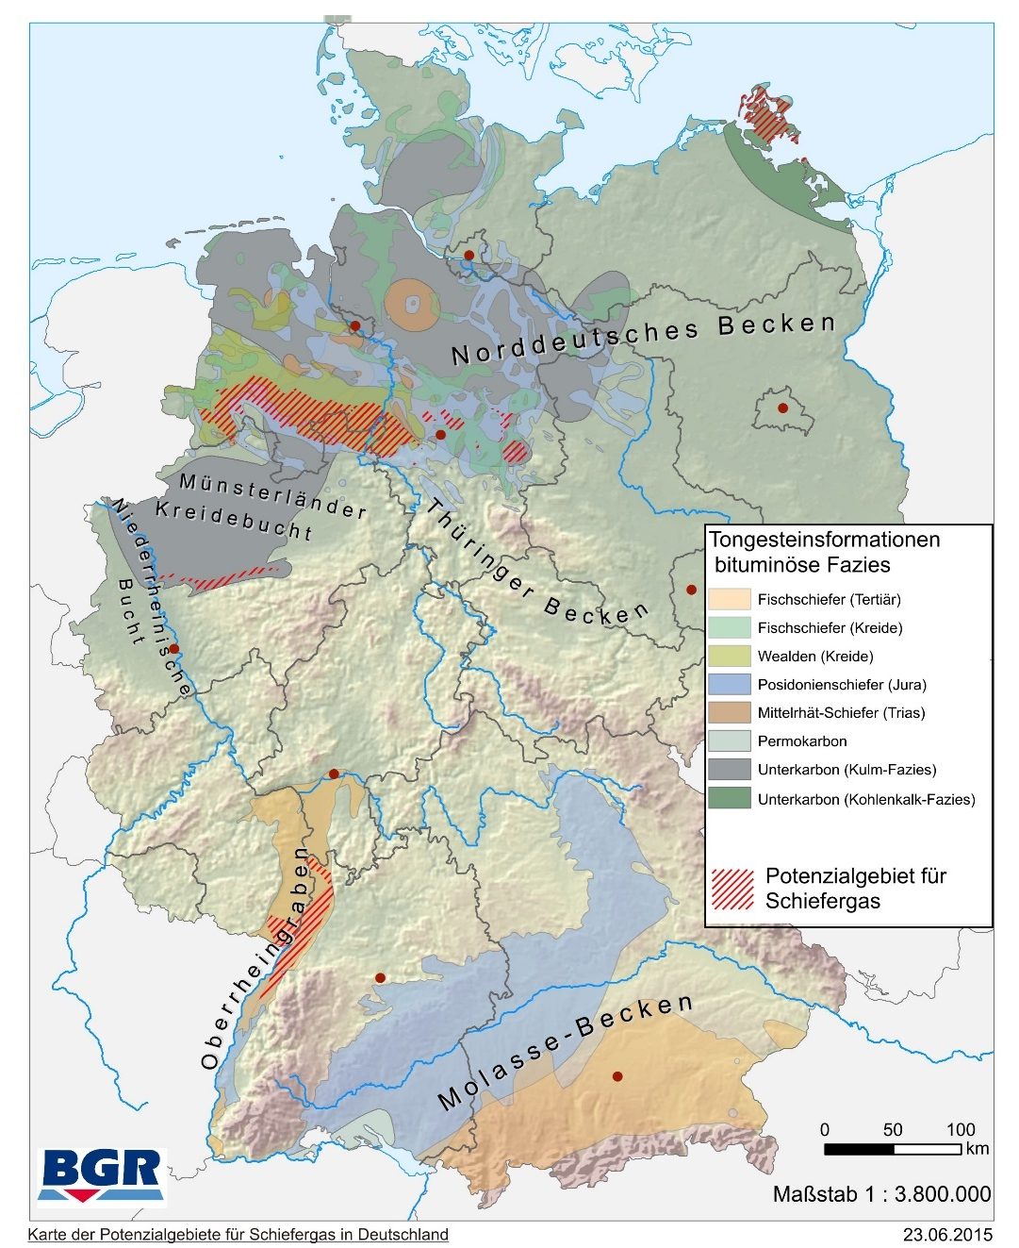
Germany’s Shale Gas Potential
  Potential Geologic Formations (recent assessment)
Area with shale gas potential
Notes:
Formations: Creataceous Wealden; Jurassic Posidonia; Lower Carboniferous „Alaun-Shales“
Sehr lückenhafte Datenlage im NW, vergleichsweise gute Datenlage im NE
-
tcm : engl. trillion cubic meter = deutsch Billionen Kubikmeter
10^12 cubic meter
1 tcm ~ 35 tcf
13 tcm ~ 459 tcf

Slide 13
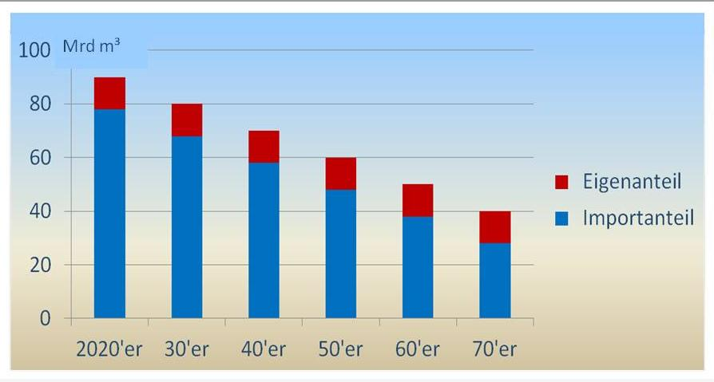
Availability of Shale Gas
Scenario: In 2010 Germany‘s natural gas requirement was about 100 Billion m³.
Assumption 1: Decrease of 10 Billion m³/decade, due to energy transition. Assumption 2: 720 Billion m³ domestic shale gas are recoverable.
→ for 60 years: 12 Billion m³/annum … in the period 2020 to 2080.
Domestic share
Import share
Notes:
2010 - 100 Mrd m3, 15 Mrd = 15,0% heimisch
2020 - 90 " , 16,7%
2030 - 80 " , 18,8%
2040 - 70 " , 21,4%
2050 - 60 " , 25,0%
2060 - 50 " , 30,0%
2070 - 40 " , 37,5%
2080 - 30 " , 50,0%
2090 - 20 " , 75,0%
2100 - 10 " , 150,0% = Selbstversorger und Exporteur
2110 - 0 " , Exporteur

Slide 14
Economic Relevance (Dimension)
  Contribution to long-term stability of energy prices
  affordable energy
  investment security
Commodity value:
(Currency drain)
12 Bn. m³ ~ 4 Bn. €
~ 40 Bn. € / decade
ca. 10,000 mainly high-classified jobs*:
economical value ~ 1.0 Bn. € / annum
incl. taxes/charges ~ 0.2 Bn. € / annum
~ 2 Bn. € / decade
  Further 10,000 in periphery
Investment:
Orders to third parties ~ Bn. € / annum
Royalties:
to the states: ~ 0.7 Bn. € / annum
~ 7 Bn. € / decade
*) www.dihk.de/presse/thema-der-woche (14.08.2014)
Notes:
Dekadenblick gerechtfertigt, weil:
langlebiges business; kein hire-and-fire Markt -> Stabilität über viele Jahre
DIHK-Zitat auch:
https://erdoelerdgasdeutschland.wordpress.com/2014/08/17/dihk-fordert-sachliche-fracking-debatte/
Information Niedersächsische Staatskanzlei, 15.12.2014:
<http://www.stk.niedersachsen.de/aktuelles/presseinformationen/foerderabgabe-auf-erdoel-und-naturgas-sinkt-im-jahr-2015--schwefel-bleibt-von-foerderabgabe-befreit-129931.html>
Royalties on oil and crude gas decrease in 2015 / Sulphur remains royalty-free
Die Links verweisen zum Teil auf Seiten, die möglicherweise Daten an die Anbieter übertragen.
In their session the Lower Saxony Government decided to decrease royalties on oil by 1 percantage point from 19 to 18 %, those of crude gas from 37 to 30 %. Sulphur remains royalty-free.
The reason for decreasing the dues is the stark decline of the oil and natural gas quantities produced in Lower Saxony in the course of the past years. The considerable slump of international raw oil prices since 2014 makes for the years to come an acceleration of this development expectable. This had consequences for the supply security and the optimal use of domestic energy resources and also may hazard many working places in mostly structurally weak regions.
Definition of royalties is attached according to the legal conditions of the Federal Mining Act to the value of the natural resource. Beyond this the definition of fee rates takes into account factors like preservation of jobs and supply security.
Lower Saxony expects an income between 400 and 450 Mio € in …

Slide 15
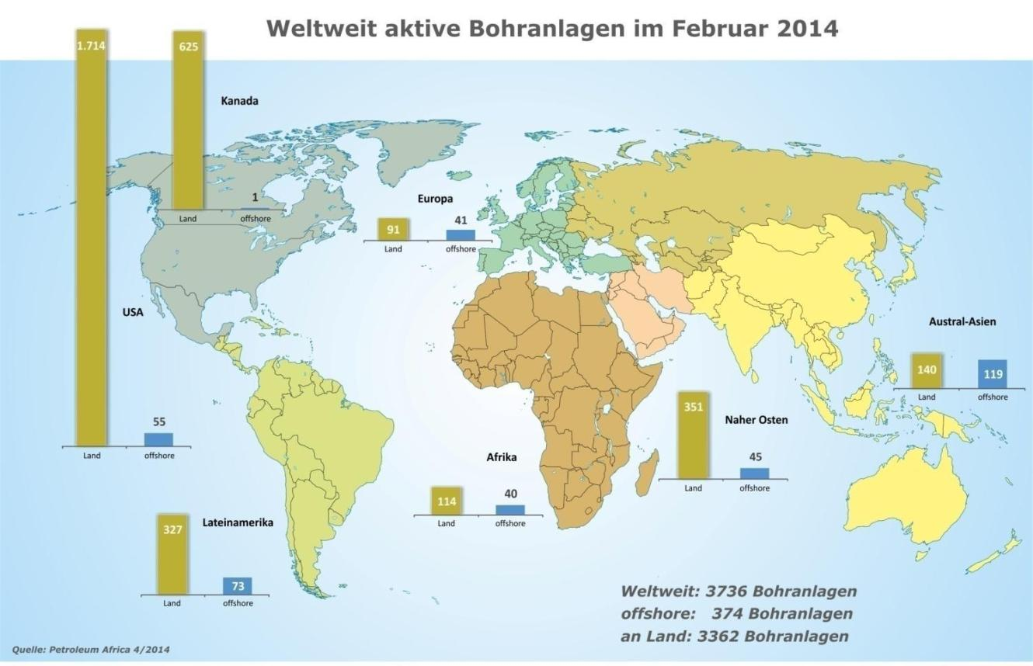
Could Domestic Production raise as swiftly as in the USA?
Active Drilling Units Worldwide (as of: Febr. 2014)
No! Neither any comparable price decrease
Statement that German shale gas only lasts
for 12 years is misleading
Worldwide: 3736 Drilling Units
Offshore: 374 Drilling Units
Onshore: 3362 Drilling Units
Source: Petroleum Africa 4/2014

Slide 16
    Rationale for Shale Gas Issue
    Assessment of Shale Gas Potential
    Skepticism in the Public

Slide 17
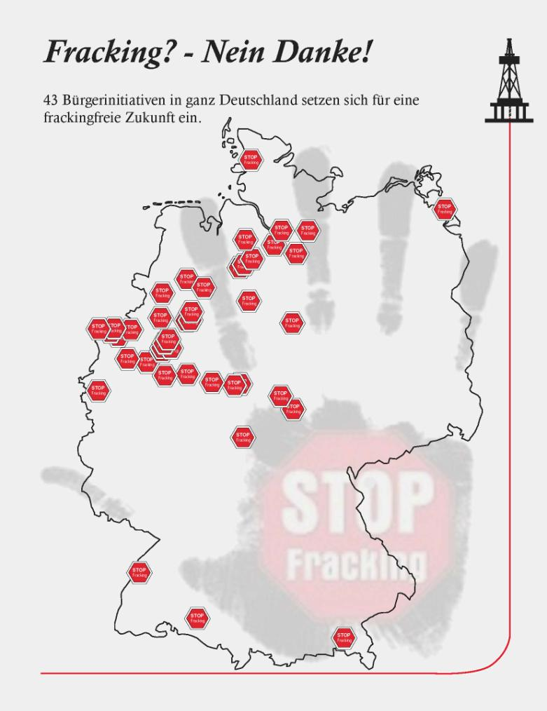

Action Groups against Fracking
Fracking? – No, thanks!
43 action groups for a fracking-free future
(as of 12.12.2014)
Verena Lange

Slide 18

















Opinion of the German State Geological Surveys
= neutral state authorities
„In as far as
the legal regulations and
the technical standards are observed
and detailed location-based preinvestigations are performed,
application of the fracking-technology is geoscientifically controlled, safe, and sustainable.“
State Geol. Surveys of Germany (Feb. 2013)
Notes:
This is no license: neither for companies nor for controlling und approval authorities nor for BGR or the geological surveys as well as geoscience research institutes: All of us must see to achieve the required social acceptance
It is important to apply and develop the technology necessary for production so that using it is safe and sustainable with the required social acceptance.

Slide 19
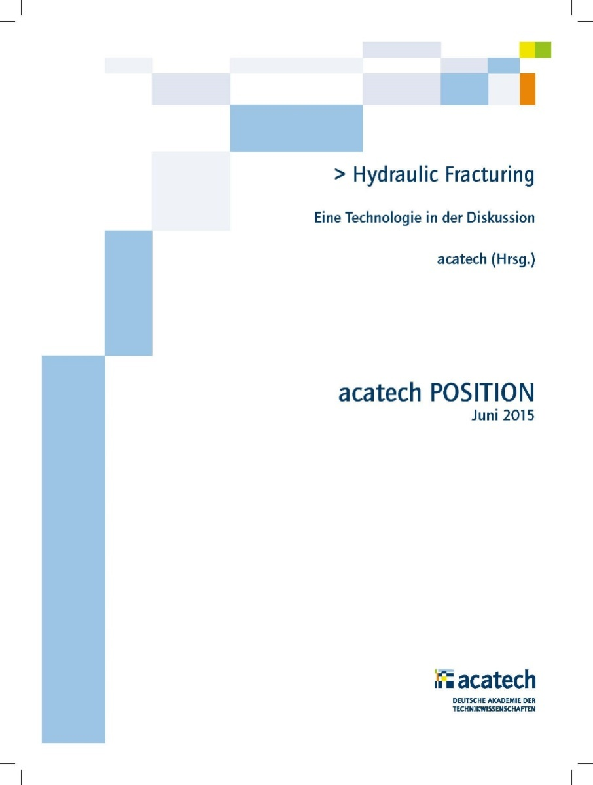
Position Paper acatech (June 2015)
Key statement:
„On the basis of scientific and technical facts a general prohibition of hydraulic fracking cannot be justified.“
[Tagesspiegel, 1.7.2015]
Notes:
Das ist kein Freibrief: weder für die Unternehmen, noch für die Aufsichts- und Genehmigungsbehörden, noch für uns als BGR oder die geologischen Dienste sowie die geowissenschaftlichen Forschungsinstitute: wir alle müssen für die erforderliche gesellschaftliche Akzeptanz sorgen.
Wichtig ist, die zu ihrer Förderung notwendigen Technologien so einzusetzen und weiterzuentwickeln, dass eine Nutzung sicher und umweltverträglich mit der erforderlichen gesellschaftlichen Akzeptanz erfolgen kann.

Slide 20
The Climate Protection Argument
Concerns
Facts
Least emission of all fossile energies → Gas should be fossile energy to be used longest.
Burning gas leads to CO₂-emission
Even with ambitious scenarios:
demand holds for decades,
at least until 2080
Energy transition is postponed
For some supplier countries: probable
For domestic production:
neglectable
CH₄ releases in shale gas production
Domestic production:
low energy consumption
due to short transits
Domestic gas has best climate budget
  Savings 5 Mio t CO₂ / a (WEG; Juni 2015)
Notes:
lt. WEG-Kompakt (Newsletter, Juni 2015):
…
Domestic oil and gas production had advantages for climate protection. By closeness to the consumer long, energy intensive transits are omitted. Consequently 5 Mio t of CO2-equivalent are prevented which come up on the natural gas-routes from abroad.
Discussion in Federal Government to save CO₂: Aim = 22 Mio t CO₂ /a (Extra-taxes by brown coal power stations)

Slide 21
What happened?
neutral
critical
Routine shale gas production (USA)
Complex situation (expert issue)
Movie „Gasland“
Isolated cases of damages
‘Encouragement‘ of some NGOs
failures: in communication,
no baseline measurements …
Subject suitable for campaigning
News value for the media
Causing uncertainty in public
„If any social current succeeds to mobilize 5 % of the population for their issue, protests, enhanced by the media, can no longer be ignored by politics.“ (O.Renn; 2011)
Tricky subject for politics
Broad rejection resp. skepticism
Self-regulation of the Free Press (news value, neutral opinion)
Economic significance (esp. Lower Saxony)
→ Legislative Procedure …
Notes:
… unconventional ideas at the end: …
„High risk technology“ :
What about biking? (~ 350 death/a; equally swimming in open waters)
What about all sorts of farming? (see groundwater pollution)
What about all and any kind of energy production?
Should we not start to dismantle our roads?

Slide 22
4 Conclusions to Fracking
The geologic shale gas potential for Germany is signifcant, yet is economically not expected to become a ‘game changer‘.
Due to highly overblown risk scenarios and inappropriate reports, skepticism in the public is understandable. Labelling fracking as risk technology, is not tenable.
State Geological Surveys and other expert groups face difficulties to find reasons for general prohibition of fracking; this is also due for a limiting depth of 3,000 m, as under consideration in Germany.
Arguments of climate protection in context of energy transition do not speak against but rather in favour fracking.
Notes:
… unkonventionelle Gedanken zum Schluss: …
„Hochrisikotechnologie“ :
Wozu gehört dann Fahrradfahren ? (~ 350 Tote jährlich; ebenso Baden in freien Gewässern)
Wozu gehört dann nahezu jegliche Art von Landwirtschaft ? (bzgl. GW-Belastung)
Müssen wir nicht anfangen, unsere Straßen abzubauen?

Slide 23

Thank you for your Interest

Slide 24
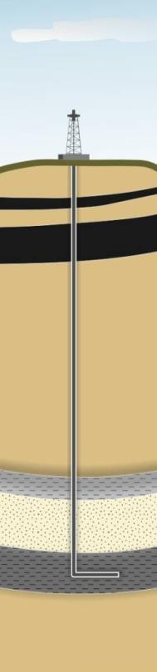
Benchmark Paper of Ministries of Economy and Technologies / Environment (July/Nov. 2014)
… concerning application of Fracking
EIA-obligation for fracking-measures
Clarifying regulations to water law related factual use and application of principle of concern
Prohibition of fracking in specified areas (water protection areas, spa protection areas, drainage area of dams and lakes used for drinking water production)
Permitted substance-concentrations and obligation to disclose substances employed
Issue of an original state report
Regulations for handling flowbacks and deposit water
Area and surface monitoring
Extensive reporting duty
Reversal of burden of proof concerning subsidence damage due to fracking-actions/deep drilling
No commercial fracking above 3000 m
Experts‘ commission comments on environmental risks (majority voting)
Fracking for scientific reasons with accompanying research possible under conditions

