Slide 1

Environmental monitoring of shale gas operations in the UK
Simon Talbot - Managing Director GGS

Slide 2




Acknowledgements and thanks to:
The Polish Geological Institute, and the
Polish Ministry of Environment
And for the finance and support from:
National Fund for Environmental Protection & Water Management, and the
The Geological Surveys of Europe

Slide 3

Environmental monitoring of shale gas operations in the UK
Current status of UK unconventional exploration
UK regulation
Baseline and operational environmental monitoring UK case study
Conclusions relevant to the whole of Europe

Slide 4


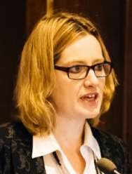
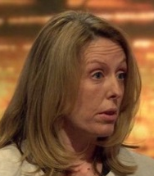
Current status of UK unconventional hydrocarbon exploration
“I want to see unconventional gas properly exploited in our country. We want to have greater energy security, we want to keep prices down, we also want to tackle climate change.” PM, David Cameron - 26 January 2015
“We should get on with the safe, environmentally protected exploration of our shale gas resources.” Chancellor, George Osborn – 17 June 2015
“This Government is clear that we have a national need to explore shale gas.” Secretary of State for Energy, Amber Rudd – 10 August 2015
"We are going to be using gas for a long time. The important thing is to minimize the carbon emissions from gas. That means if we can get our own fracked gas, its better to use that than imported gas.” Labour Shadow Energy Minister, Bryony Worthington – 10 September 2015

Slide 5
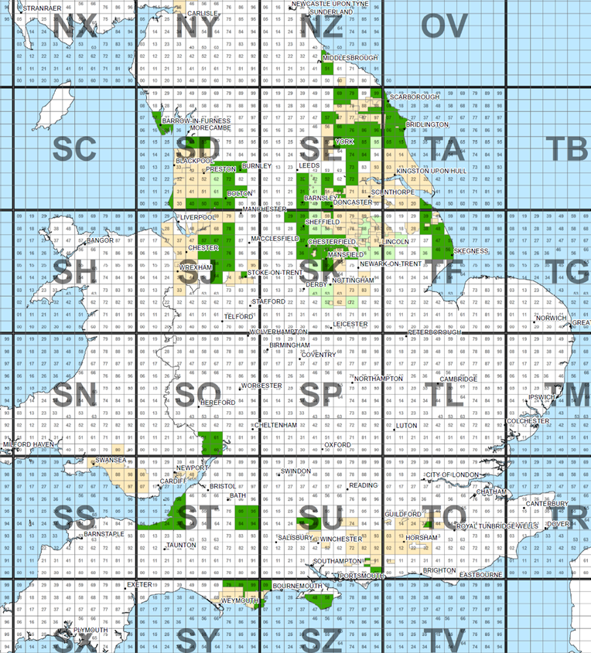
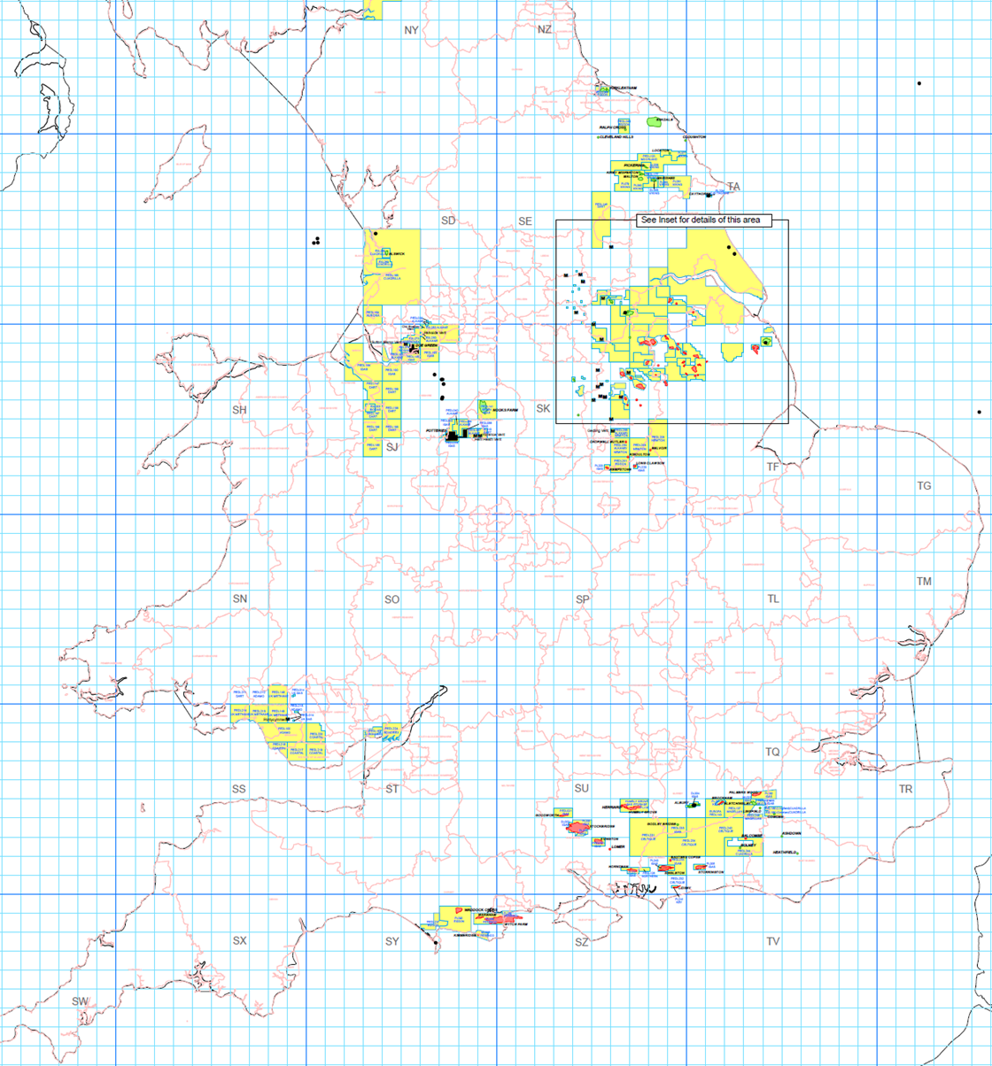
Current status of UK unconventional hydrocarbon exploration
Current
168 Existing onshore petroleum licences
14th Licencing Round (2014)
95 Applications for 295 blocks
August 2015
27 New blocks to be offered
132 blocks subject to further assessment

Slide 6
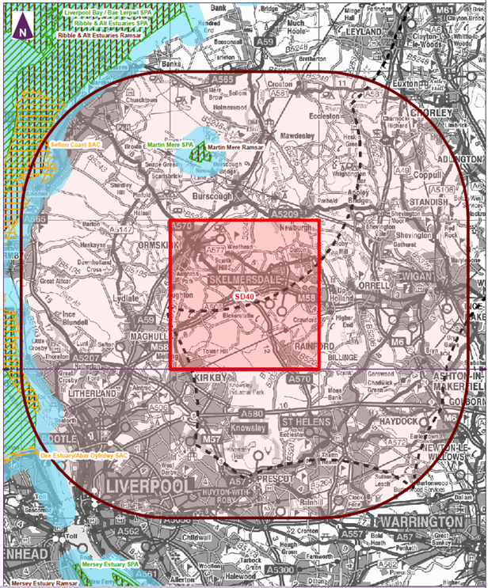
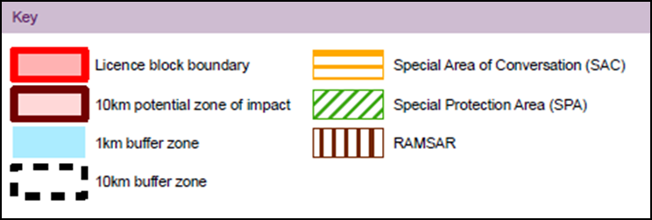
14th Licencing Round
Appropriate Assessment being carried out on 132 licence areas as required by the Habitats Directive (92/43/EEC)

Slide 7
Environmental monitoring of shale gas operations in the UK
Current status of UK unconventional exploration.
UK regulation.
Baseline and operational environmental monitoring UK case study.
Conclusions relevant to the whole of Europe.

Slide 8
UK Regulation
Four fold Regulation:
Licences issued by the Government (DECC)
Ensure operators have technical expertise and the resources
Planning Permission granted by Local Authority
Ensure that local impacts (traffic, noise, visual intrusion) are managed
Environmental Protection regulated by Environment Agency
Ensure operations do not cause harm to the environment
Well Integrity regulated by Health & Safety Executive
Check well design and installation

Slide 9
UK Environmental Regulation
Site specific and risk based
Based on:
Source – Pathway – Receptor (Pollutant Linkage)
Practical approach that:
Establishes what is at a site before operations begin
Ensures that no pollution occurs
Demonstrates that the site is returned to its original condition
Site Monitoring: Before – During – After

Slide 10
UK environmental protection in practice
Three elements:
Robust regulation (Environment Agency)
Working to best practice (Industry guidelines)
Independent monitoring (providing the evidence)

Slide 11

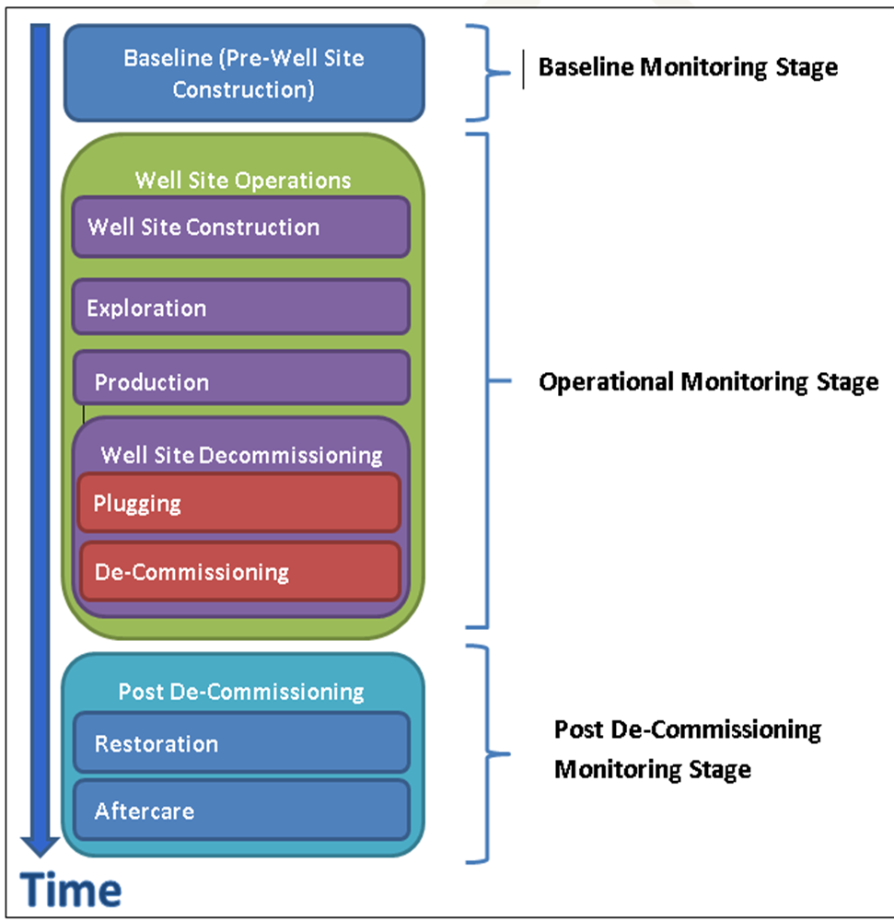
UK Best practice to Baseline Monitoring

Slide 12

Baseline Monitoring
Desk-Study
Desk-study has to be carried out at least 12 months before site operations start
Risk Assessment
A couple of weeks
Conceptual Site Model
Monitoring Programme
12 months
Site Operations Start Date

Slide 13
Environmental monitoring of shale gas operations in the UK
Current status of UK unconventional exploration.
UK regulation.
Baseline and operational environmental monitoring UK case study.
Conclusions relevant to the whole of Europe.

Slide 14
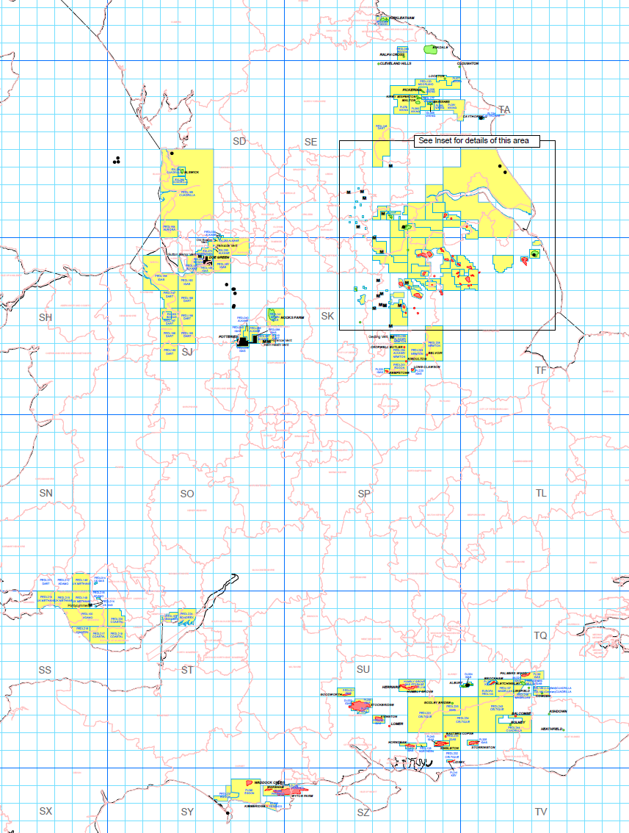
Existing 168 Licences
Preese Hall
Westby
Singleton
Banks
Around 200 conventional oil and gas production wells
Focus is moving to the underlying source rocks
GGS has been involved with 6 sites
Barton Moss
Balcombe

Slide 15

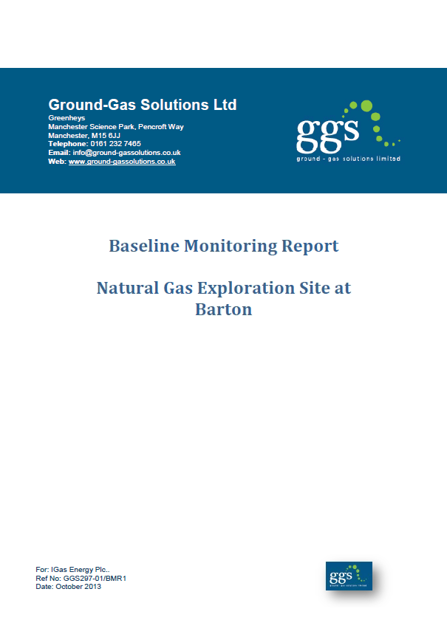
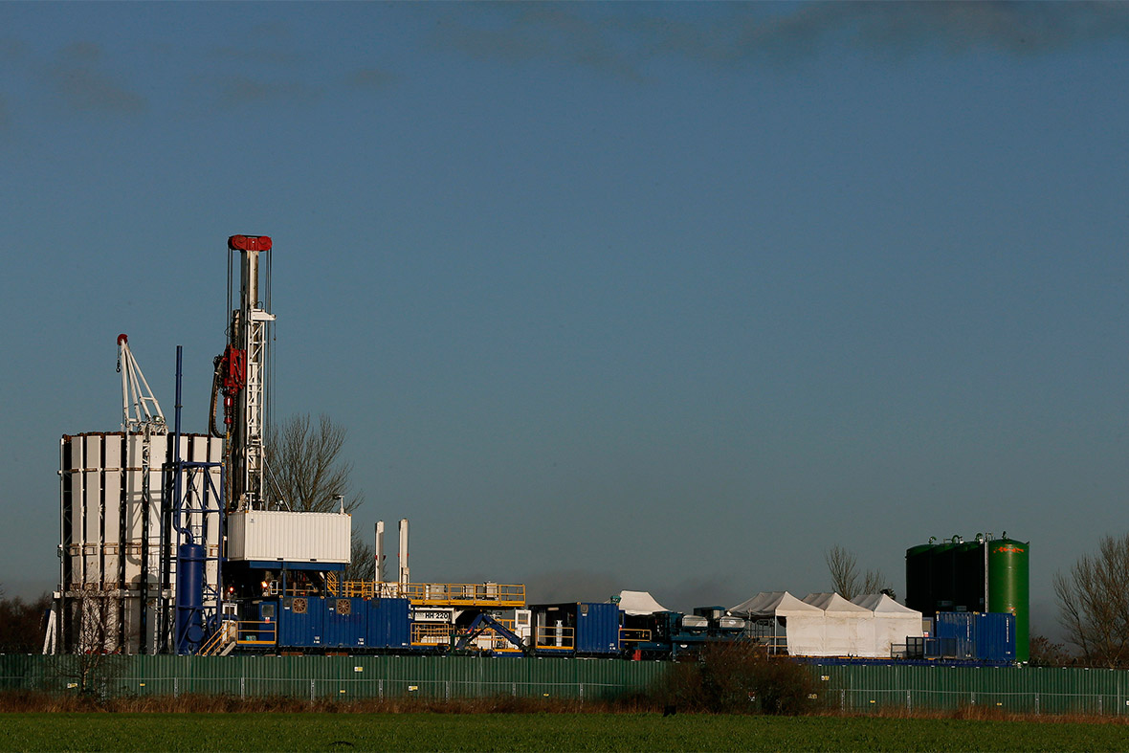
IGas - Barton Moss Case Study
http://www.igas-engage.co.uk/our-work-in-barton-moss/
Copyright (Reuters)
Notes:
My talk will cover the following areas:
A brief introduction to time-series data and how it compares to conventional spot sampling information.
Then into some of the tools we can use with time-series data
Environmental correlations
Borehole purge and recovery tests
Concentration Duration
Differential Pressure Drivers
Then I’ll finish with the on-going research and current developments including the monitoring and interpretation of VOC time series data.

Slide 16
Baseline Desk-Study
Use published sources of information & walk over:
Drift geology Solid geology Coal mining Hydrogeology Groundwater abstractions Site history | Surface water features Landfills Potential sources of methane Air quality Existing sources of emissions
Identify potential ‘Pollutant Linkages’
(Source – Pathway – Receptors)
Assess sensitivities and risks
Create ‘Conceptual Site Model’
Notes:
My talk will cover the following areas:
A brief introduction to time-series data and how it compares to conventional spot sampling information.
Then into some of the tools we can use with time-series data
Environmental correlations
Borehole purge and recovery tests
Concentration Duration
Differential Pressure Drivers
Then I’ll finish with the on-going research and current developments including the monitoring and interpretation of VOC time series data.

Slide 17
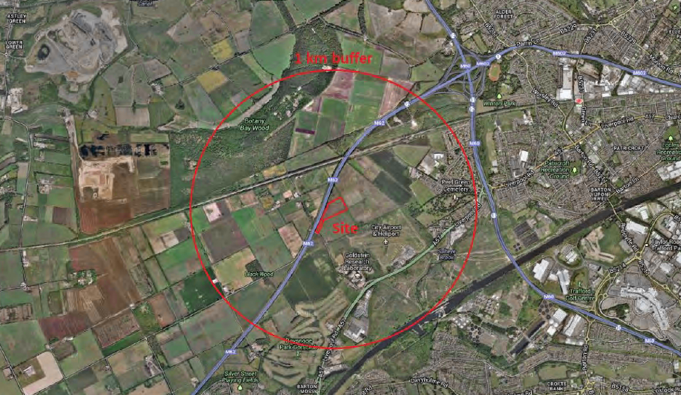
Baseline Desk Study
I
Notes:
My talk will cover the following areas:
A brief introduction to time-series data and how it compares to conventional spot sampling information.
Then into some of the tools we can use with time-series data
Environmental correlations
Borehole purge and recovery tests
Concentration Duration
Differential Pressure Drivers
Then I’ll finish with the on-going research and current developments including the monitoring and interpretation of VOC time series data.

Slide 18
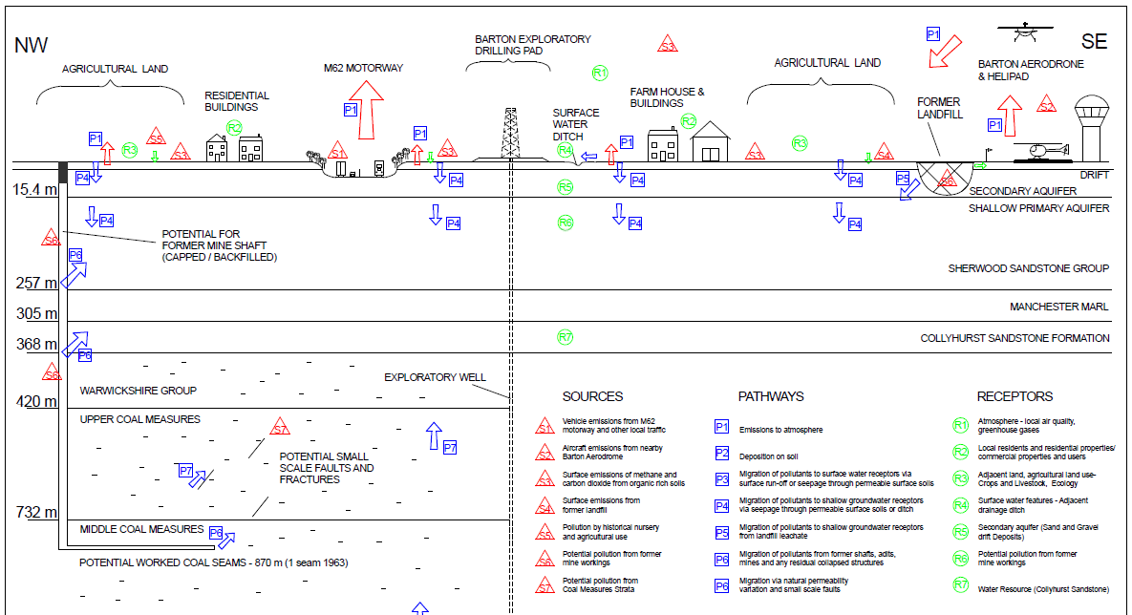
C
Conceptual Site Model – Barton Moss
I
Courtesy IGas
Notes:
My talk will cover the following areas:
A brief introduction to time-series data and how it compares to conventional spot sampling information.
Then into some of the tools we can use with time-series data
Environmental correlations
Borehole purge and recovery tests
Concentration Duration
Differential Pressure Drivers
Then I’ll finish with the on-going research and current developments including the monitoring and interpretation of VOC time series data.

Slide 19
Barton Moss - Baseline Monitoring
Surface Soil Samples
Soil samples taken and analysed
Surface Methane Emission Survey
Whole of pad area and surrounding field
Ground-Gas
Continuous Monitoring
Sampling and laboratory analysis - Composition, Isotopics & VOCs
Groundwater
Continuous Water Quality Monitoring
Sampling and laboratory analysis, Dissolved Gases
Standard suite determinants
Surface Water
Standard suite determinants
Air Quality – On-Site
Diffusion Tubes – Long-term time averaged sampling and analysis
Active Tubes – short time averaged sampling and analysis
Dust Monitoring – long term time averaged sampling and analysis
Continuous Particulate Matter
Air Quality – Off-Site, Nearest Residential Receptors
Diffusion Tubes – Long-term time averaged sampling and analysis
Notes:
My talk will cover the following areas:
A brief introduction to time-series data and how it compares to conventional spot sampling information.
Then into some of the tools we can use with time-series data
Environmental correlations
Borehole purge and recovery tests
Concentration Duration
Differential Pressure Drivers
Then I’ll finish with the on-going research and current developments including the monitoring and interpretation of VOC time series data.

Slide 20
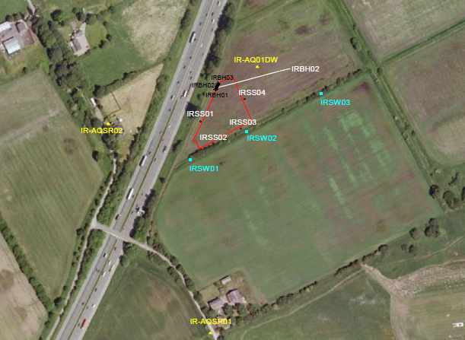
Sampling location plan
I
Notes:
My talk will cover the following areas:
A brief introduction to time-series data and how it compares to conventional spot sampling information.
Then into some of the tools we can use with time-series data
Environmental correlations
Borehole purge and recovery tests
Concentration Duration
Differential Pressure Drivers
Then I’ll finish with the on-going research and current developments including the monitoring and interpretation of VOC time series data.

Slide 21
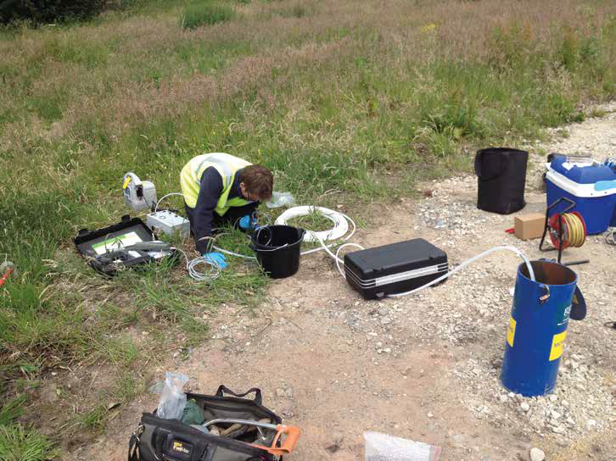
Baseline groundwater sampling
Notes:
My talk will cover the following areas:
A brief introduction to time-series data and how it compares to conventional spot sampling information.
Then into some of the tools we can use with time-series data
Environmental correlations
Borehole purge and recovery tests
Concentration Duration
Differential Pressure Drivers
Then I’ll finish with the on-going research and current developments including the monitoring and interpretation of VOC time series data.

Slide 22
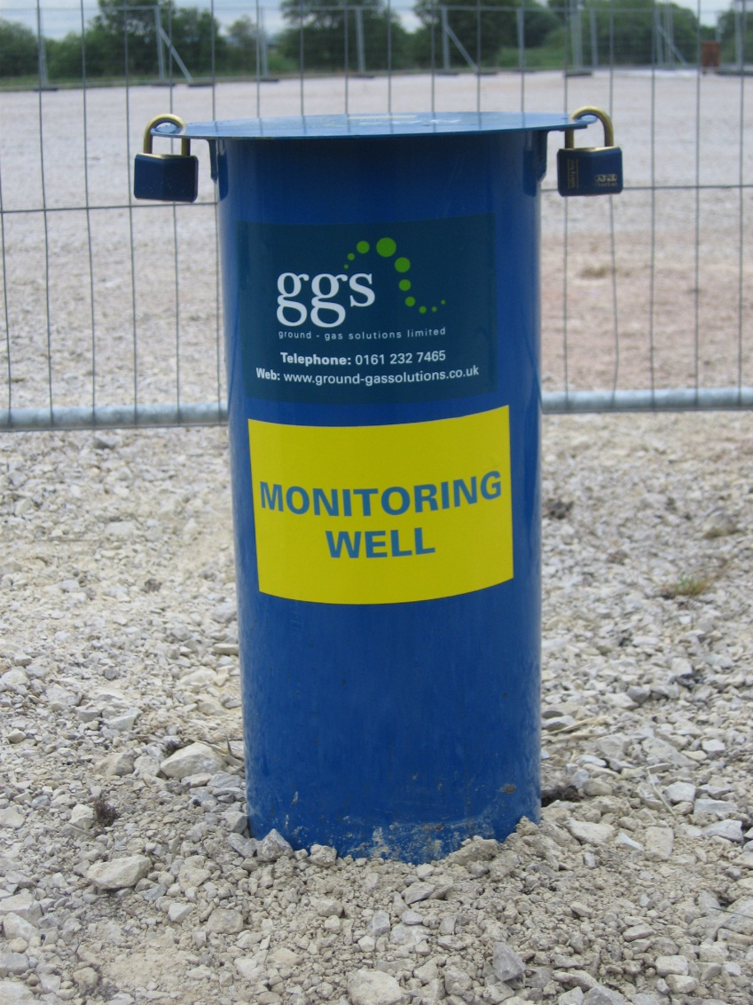
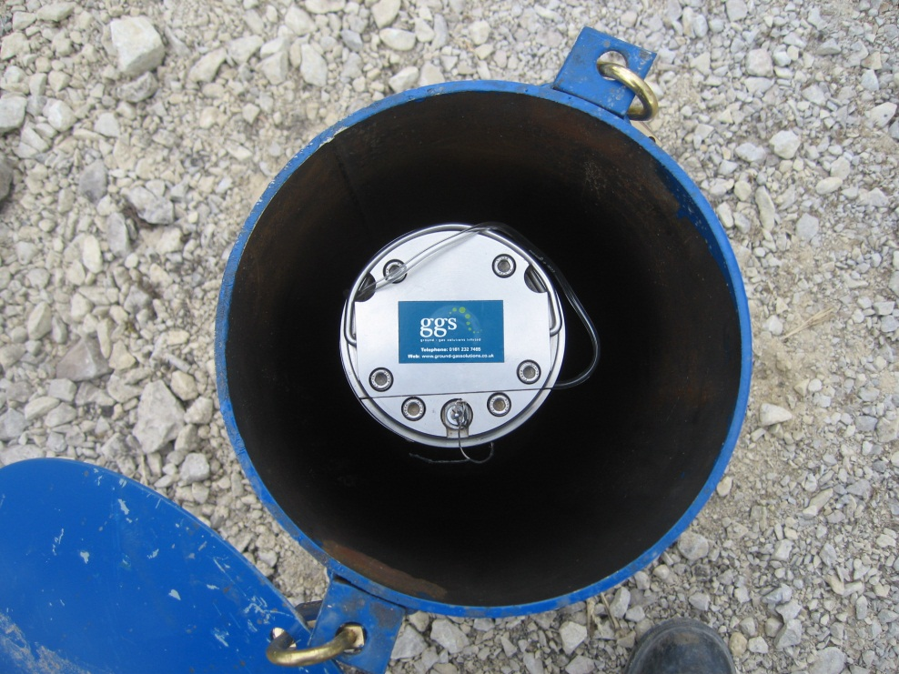
Continuous monitoring
I
Notes:
My talk will cover the following areas:
A brief introduction to time-series data and how it compares to conventional spot sampling information.
Then into some of the tools we can use with time-series data
Environmental correlations
Borehole purge and recovery tests
Concentration Duration
Differential Pressure Drivers
Then I’ll finish with the on-going research and current developments including the monitoring and interpretation of VOC time series data.

Slide 23
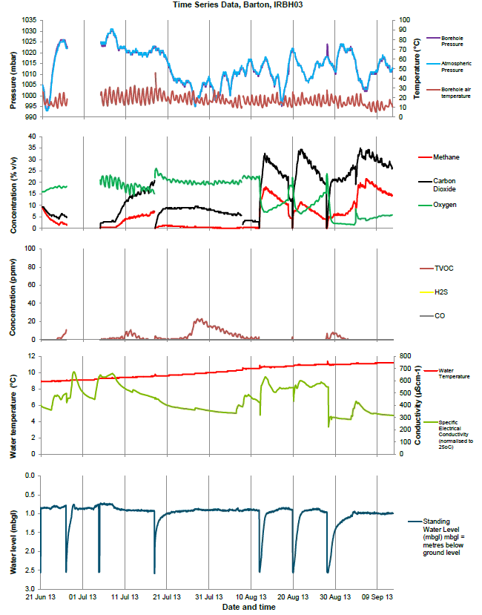
Continuous monitoring data
Atmospheric pressure & temperature
Bulk gases
Trace gases
Water temperature and electrical conductivity
Water level
I
Notes:
My talk will cover the following areas:
A brief introduction to time-series data and how it compares to conventional spot sampling information.
Then into some of the tools we can use with time-series data
Environmental correlations
Borehole purge and recovery tests
Concentration Duration
Differential Pressure Drivers
Then I’ll finish with the on-going research and current developments including the monitoring and interpretation of VOC time series data.

Slide 24
Environmental monitoring of shale gas operations in the UK
Current status of UK unconventional exploration.
UK regulation.
Baseline and operational environmental monitoring UK case study.
Conclusions relevant to the whole of Europe.

Slide 25

Sensational media reporting

Slide 26

Fear in local communities

Slide 27
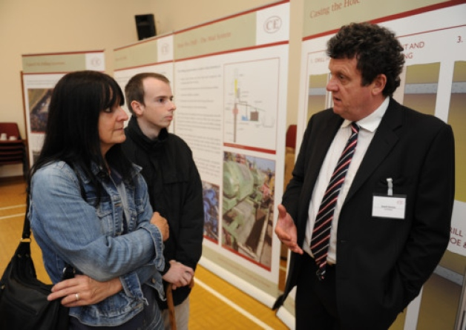
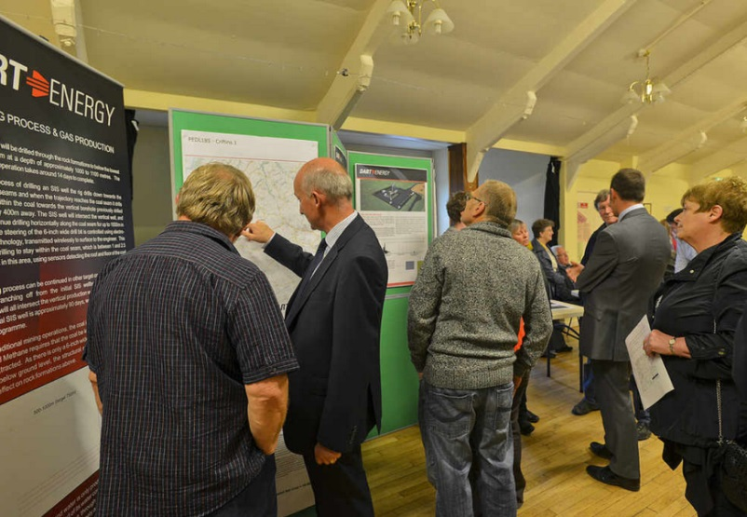
Public engagement challenge
There are genuine local concerns:
Contamination of aquifers
Surface spills
Noise
Traffic
Air pollution
We need to communicate better!
So what are the key messages?
Courtesy : Derek Martin, West Sussex Gazette
Courtesy: Shropshire Star

Slide 28
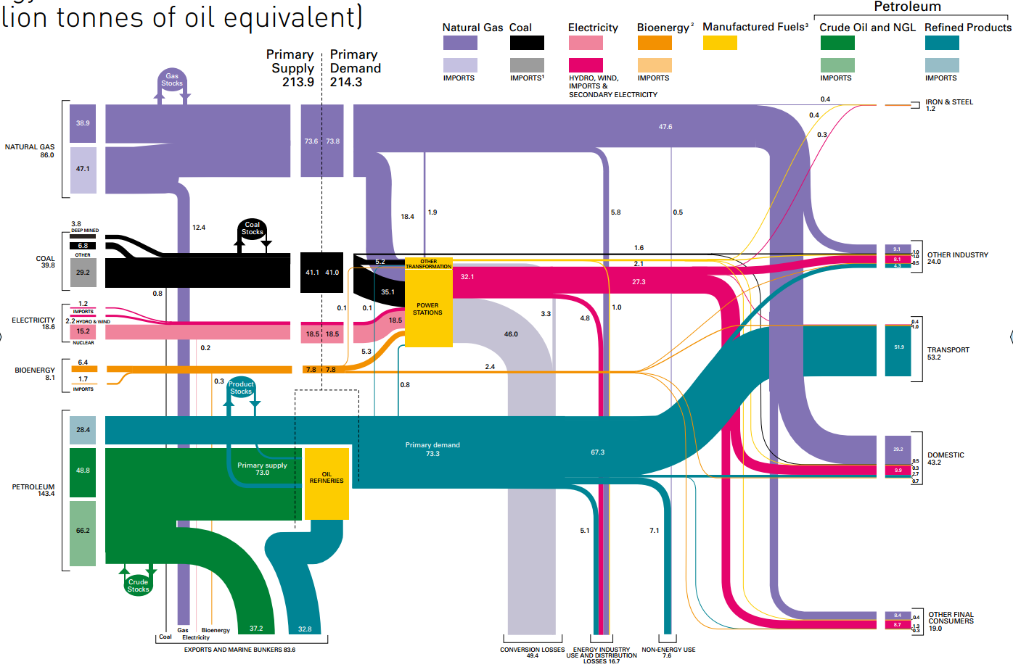
UK Energy Flow Chart 2012 - Source DECC
We need a lot of energy
Climate change is happening
We need to move to low carbon solutions
Renewables and new technologies need to be developed
Unconventional hydrocarbons are a necessary interim fuel

Slide 29
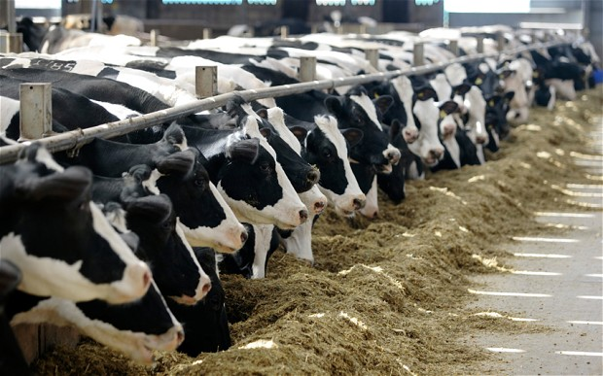
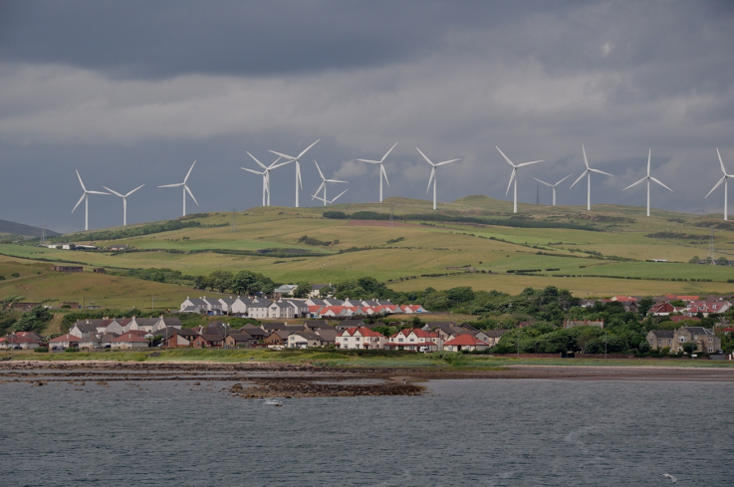
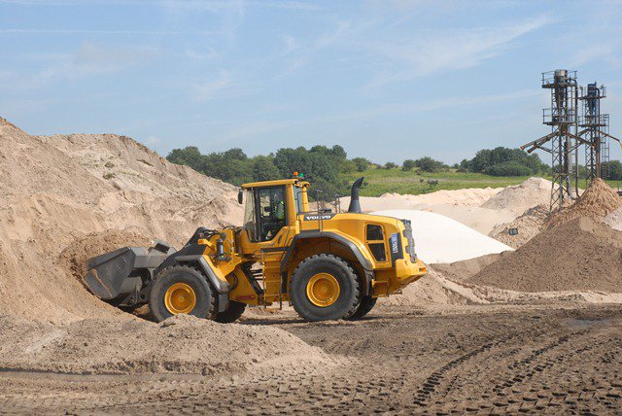
There are local impacts
Traffic
Noise
Visual intrusion
But these impacts are similar to other established activities and they will be effectively regulated.

Slide 30
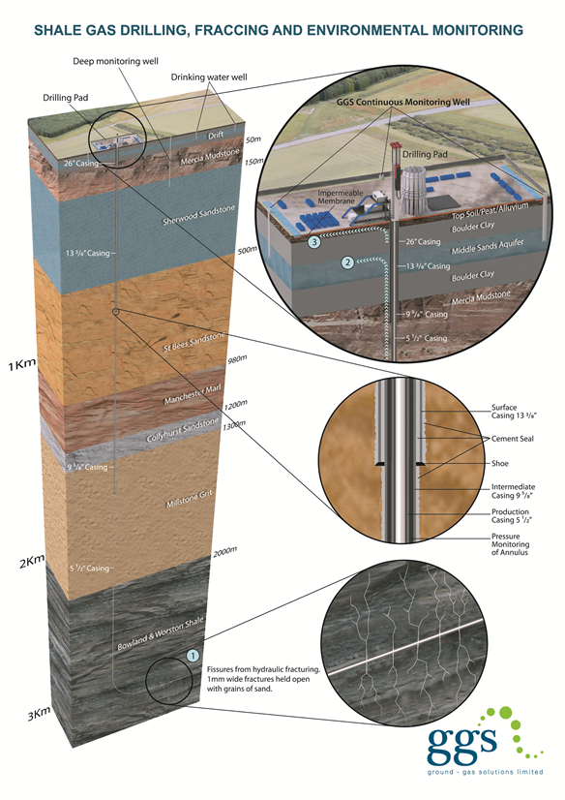
Shale gas operations can be done safely
They will not cause widespread:
Earthquakes
Water pollution
Subsidence
Accelerated climate change

Slide 31

Unconventional Hydrocarbons are an essential element of Europe's energy future
“I want to see unconventional gas properly exploited in our country. We want to have greater energy security, we want to keep prices down, we also want to tackle climate change.” PM, David Cameron - 26 January 2015
Thank you

