Slide 1
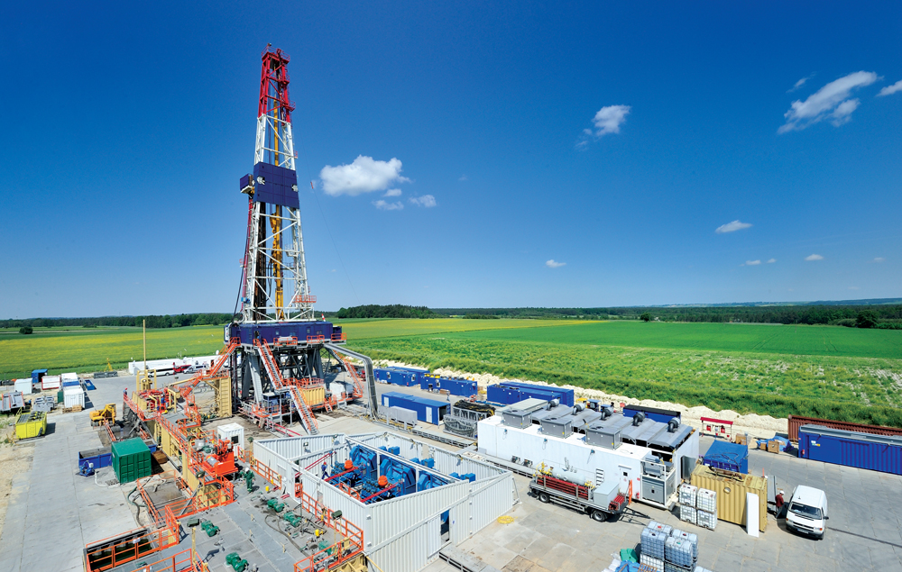
Unconventional
hydrocarbons in Poland – dissapointment or
a lesson for future?
GRZEGORZ PIEŃKOWSKI
Polish Geological Institute
National Research Institute

Slide 2
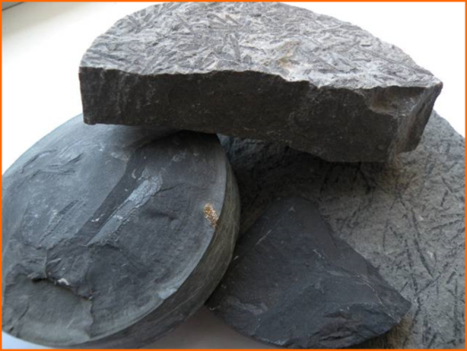
Unconventional hydrocarbons
Hydraulic fracturing applied

Slide 3
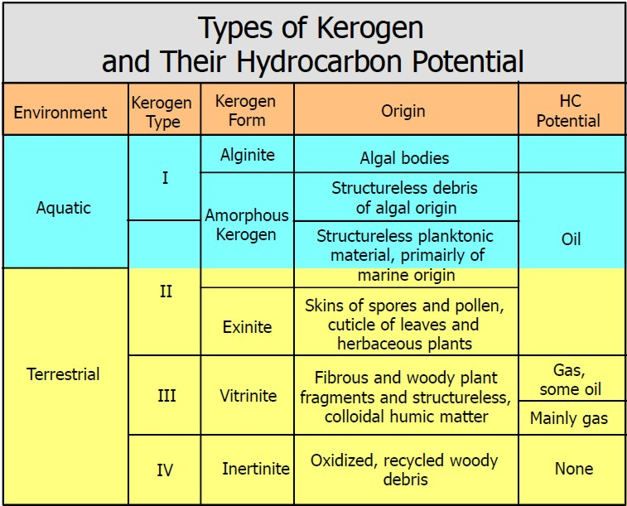

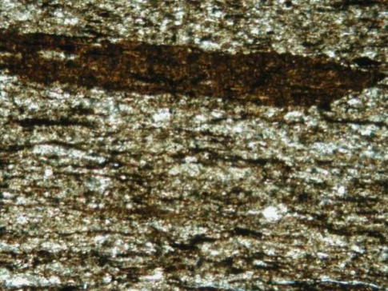
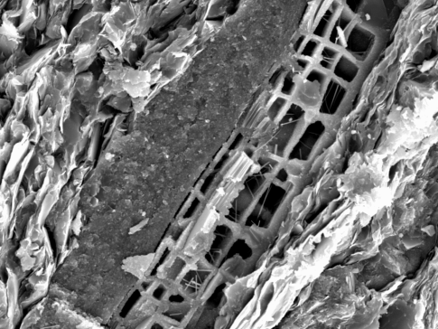
Organic carbon (or kerogen) – source of hydrocarbons – key parameter for all hydrocarbon plays (TOC = Total Organic Carbon)
Gas-bearing shale
Organic carbon
Microporosity

Slide 4
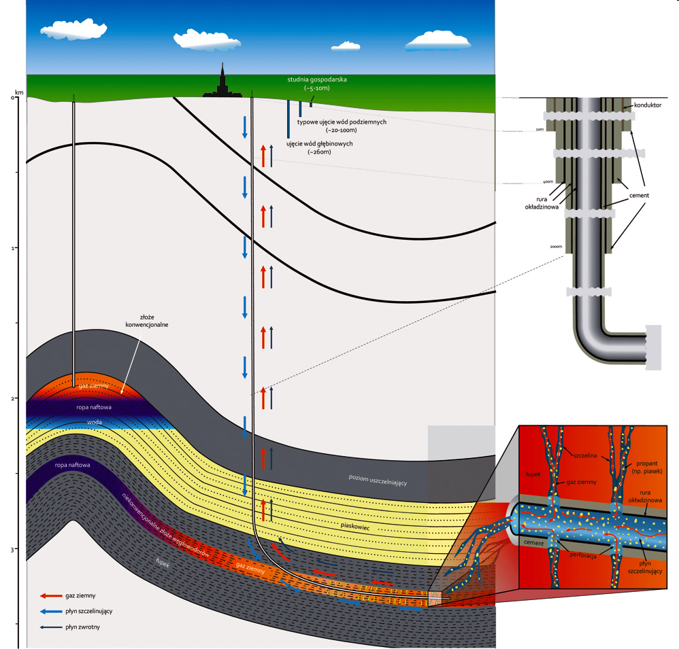
Conventional and unconventional hydrocarbons - the same kind of source rock – hydrocarbons migration makes the difference
conventional
unconventional

Slide 5
Main screening criteria for gas/oil plays in siliciclastic source rocks - “shale gas/oil”
Presence of conventional hydrocarbons in the basin
Present day Total Organic Carbon (TOC) contents > 2.0 %
Gas saturation and presure caused by hydrocarbon generation
Net thickness of hydrocarbon bearing interval > 15 meters
Preferably marine organic matter
Right thermal maturity („thermometer” Ro > 1.1 %, < 3.5 %)
High silica/carbonate contents, low clay mineral contents – high brittleness
Low burial depth (<4000 m) – depends on economics
Simple tectonic setting (but sometimes tectonic deformation can help)

Slide 6
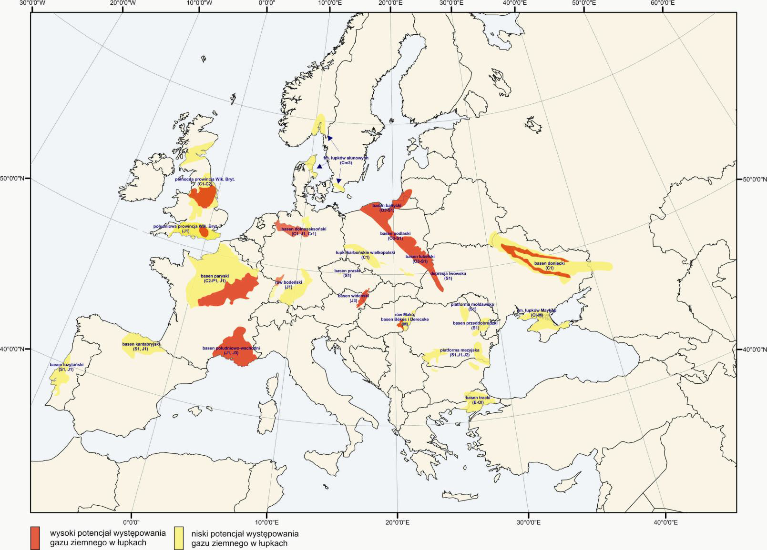
European onshore resources and the Polish Basin – on this map from 2012 still marked as a whole of a „high potential”

Slide 7
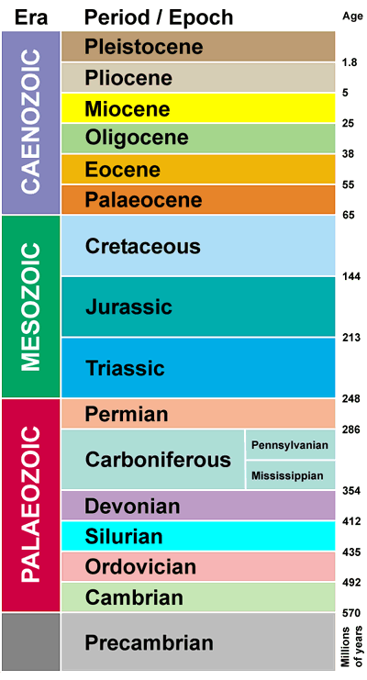

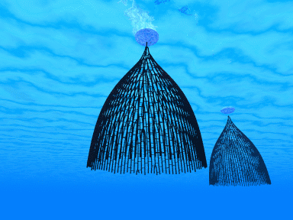

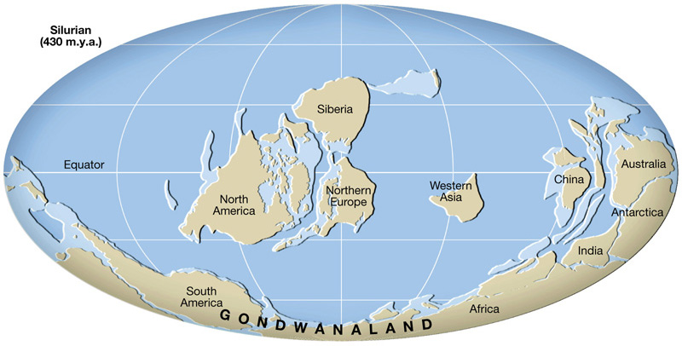
Short geological introduction - Upper Ordovician – Lower Silurian (c. 430 – 450 Mya) – our main (geological) time of interest in Poland

Slide 8
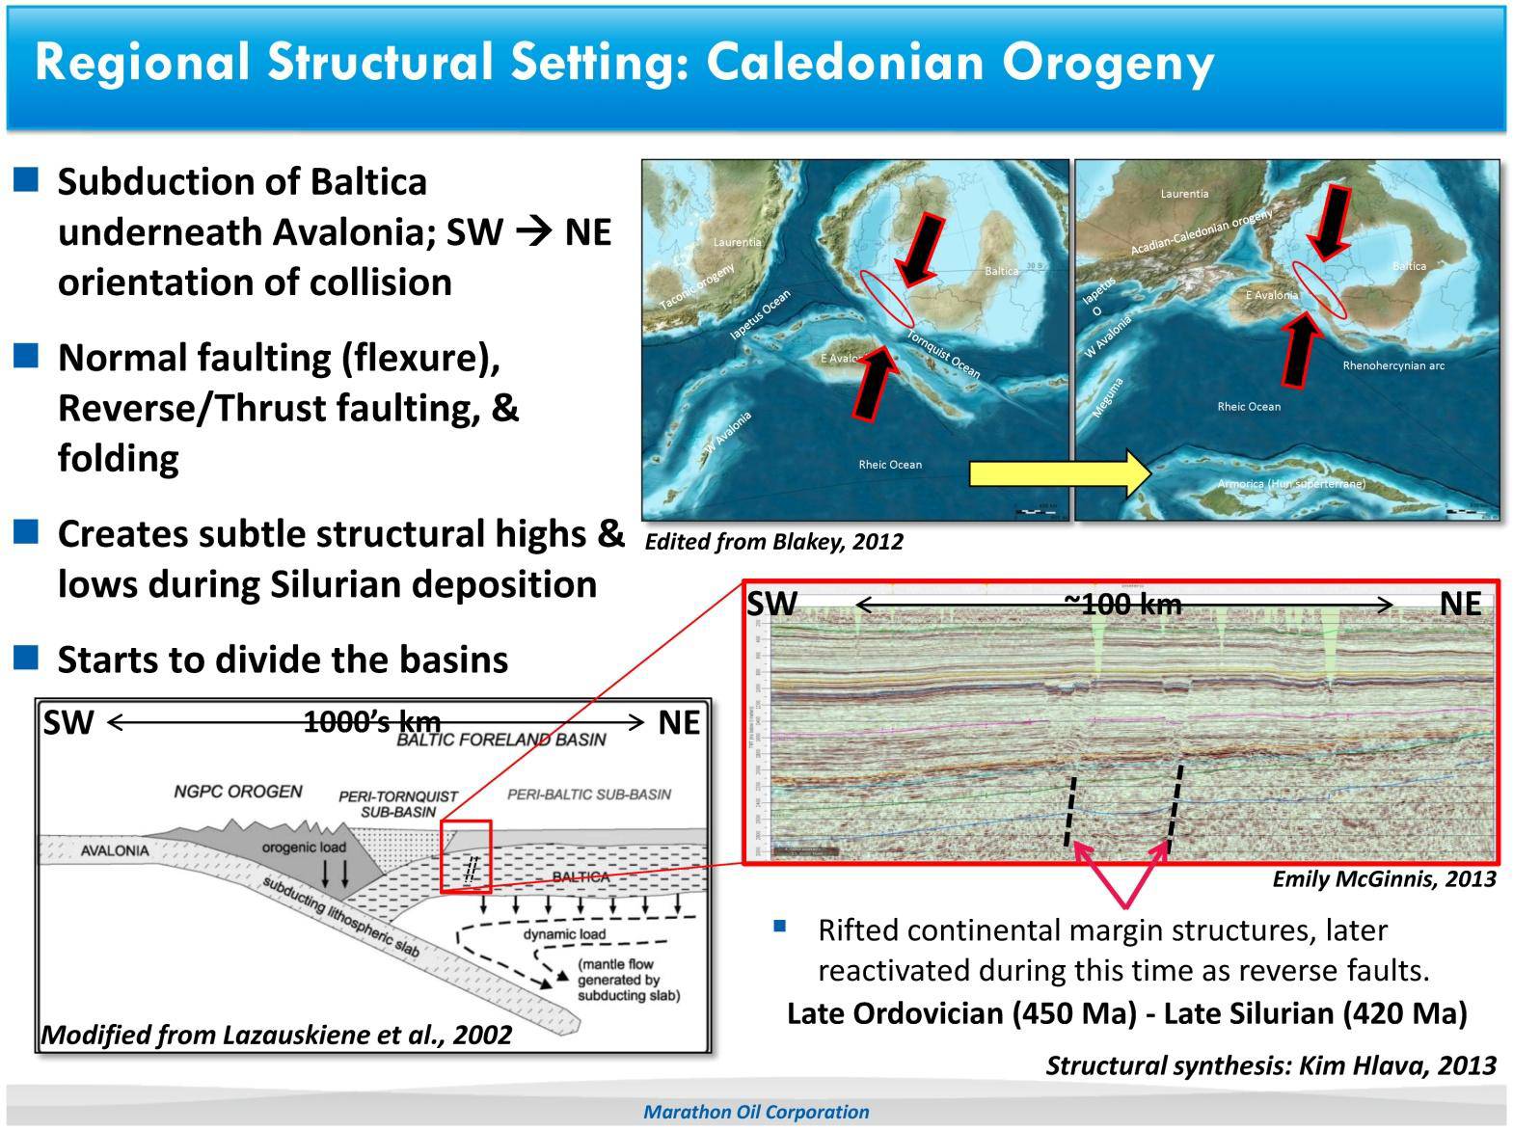
POLISH BASIN DURING A LATE PHASE OF CALEDONIAN OROGENY
collision

Slide 9
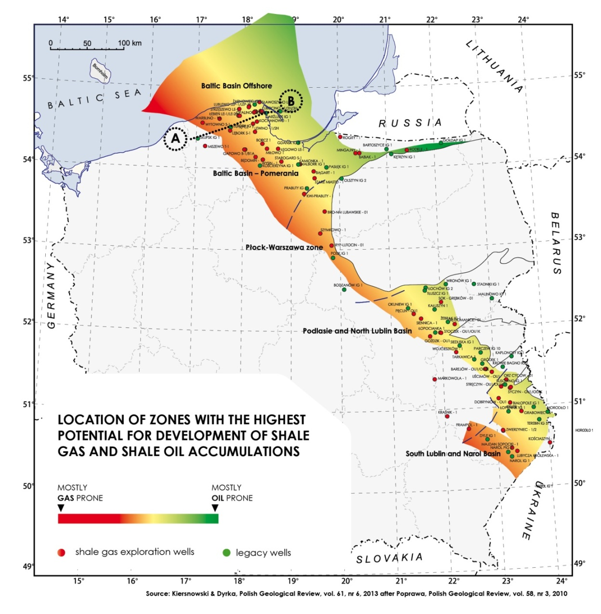
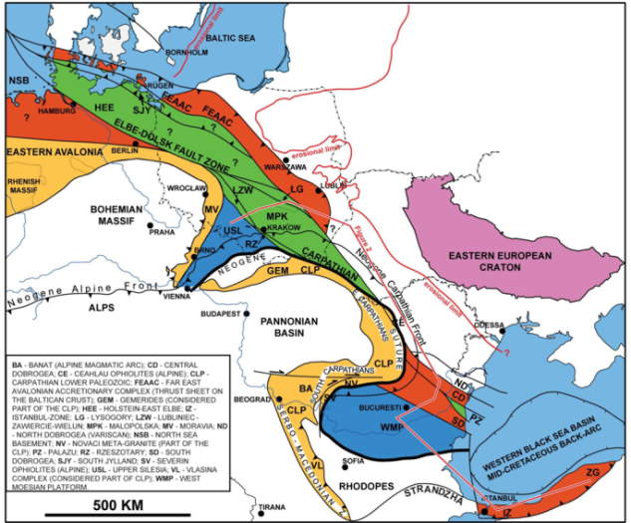
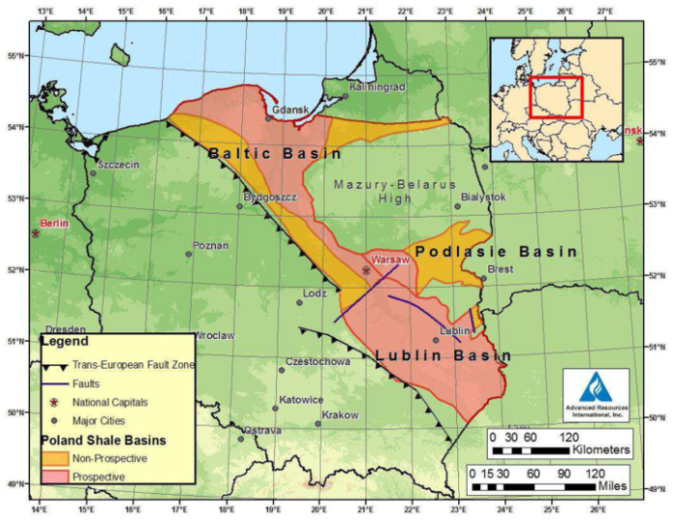
Polish Basin as a part of trans-European Caledonian basin
Caledonian foredeep basin extends beyond Poland (Oczlon, 2007)
Baltic Basin
Lublin Basin

Slide 10
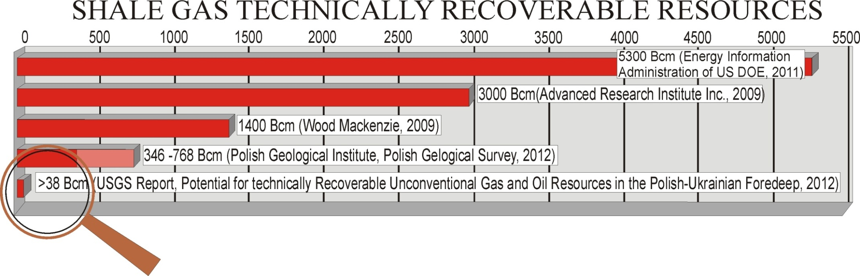
Big hopes, then great disparities in estimations
150 Bcm a year! Same amount as Europe imports from Gasprom! That stirred imagination and entry into Poland of Exxon Mobil and other giants.
Recovery factors based on multiple analogous North American shale plays !!!
Polish shale belt (although generally thick) is far from being uniform in terms of shale gas properties – this resulted in these dramatically different estimations, (still based on archival materials!)
Although still limited, (70 wells, of which just 12 hydraulically fractured), the new data allowed better understanding of the shale play in Poland – and actually may tell us what we can expect elsewhere in Europe

Slide 11
Still on the way towards first success…
Shale gas prospecting in Poland - list of completed boreholes with well stimulation indicated (for 01.01.2015 r.)
Kind of well stimulation | Number of vertical boreholes | Number of boreholes with horizontal sections | Total
Hydraulic fracturing | 13 | 12 | 25
Only microfracturing / DFIT* | 4 | 0 | 4
No hydraulic fracturing | 37 | 4 | 41
Total | 54 | 16 | 70
24500 m³/day (achieved in one borehole), and 11.000 to 15.000 in few others - it is not enough to keep a big company in Poland – to meet the global standards, they would expect at least three times more…
DFIT – Diagnostic Fracture Injection Test
This nubmber is highest in Europe, but very low when compared
to American figures

Slide 12
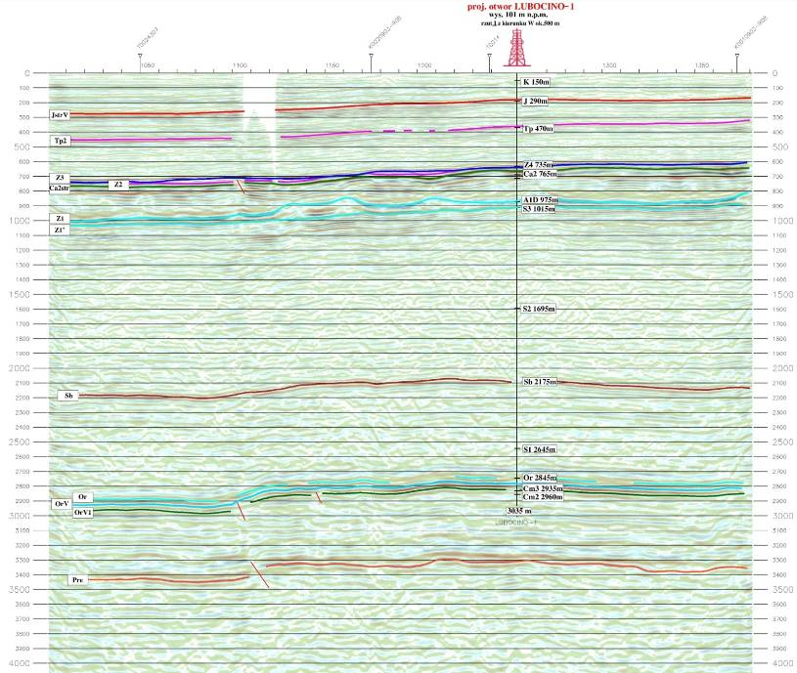
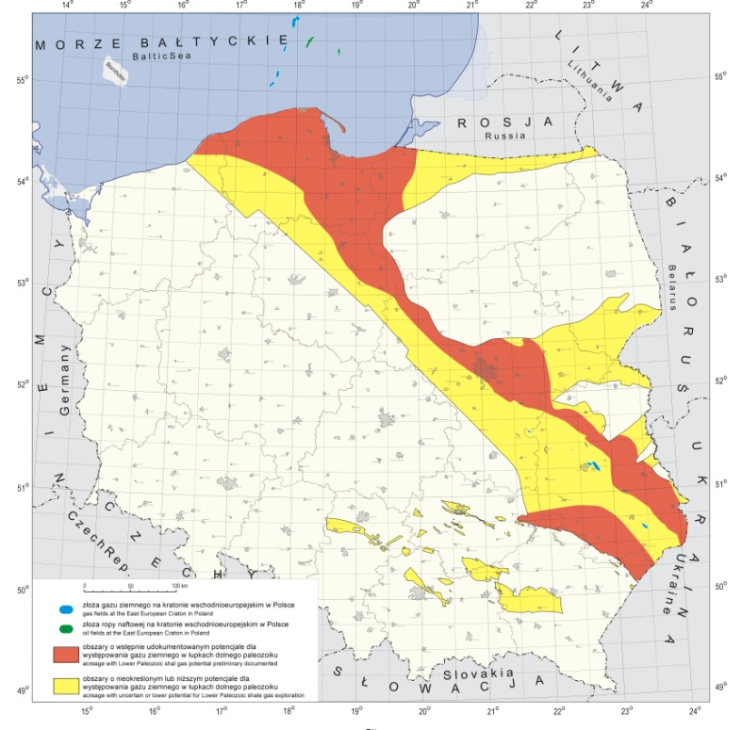
PGNiG Lubocino 1 well
and main geological targets
Eifel Tower
Lower Silurian
Shale gas/oil prone – 700 m
Hydraulic fracturing – 2894 – 2907 m
Ordovician
12

Slide 13
THERE IS NO THICK, UNIFORM, HYDROCARBON – RICH, SHALE BELT ACROSS POLAND - ALTHOUGH AT A FIRST GLANCE IT SEEMED TO BE THE CASE…
IN QUEST FOR SWEET SPOTS

Slide 14
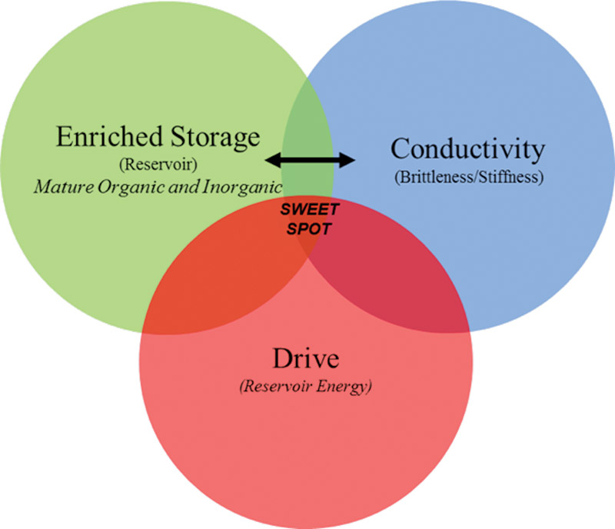
WHAT IS SWEET SPOT?
= Pressure
After: Ottmann & Bohacs

Slide 15
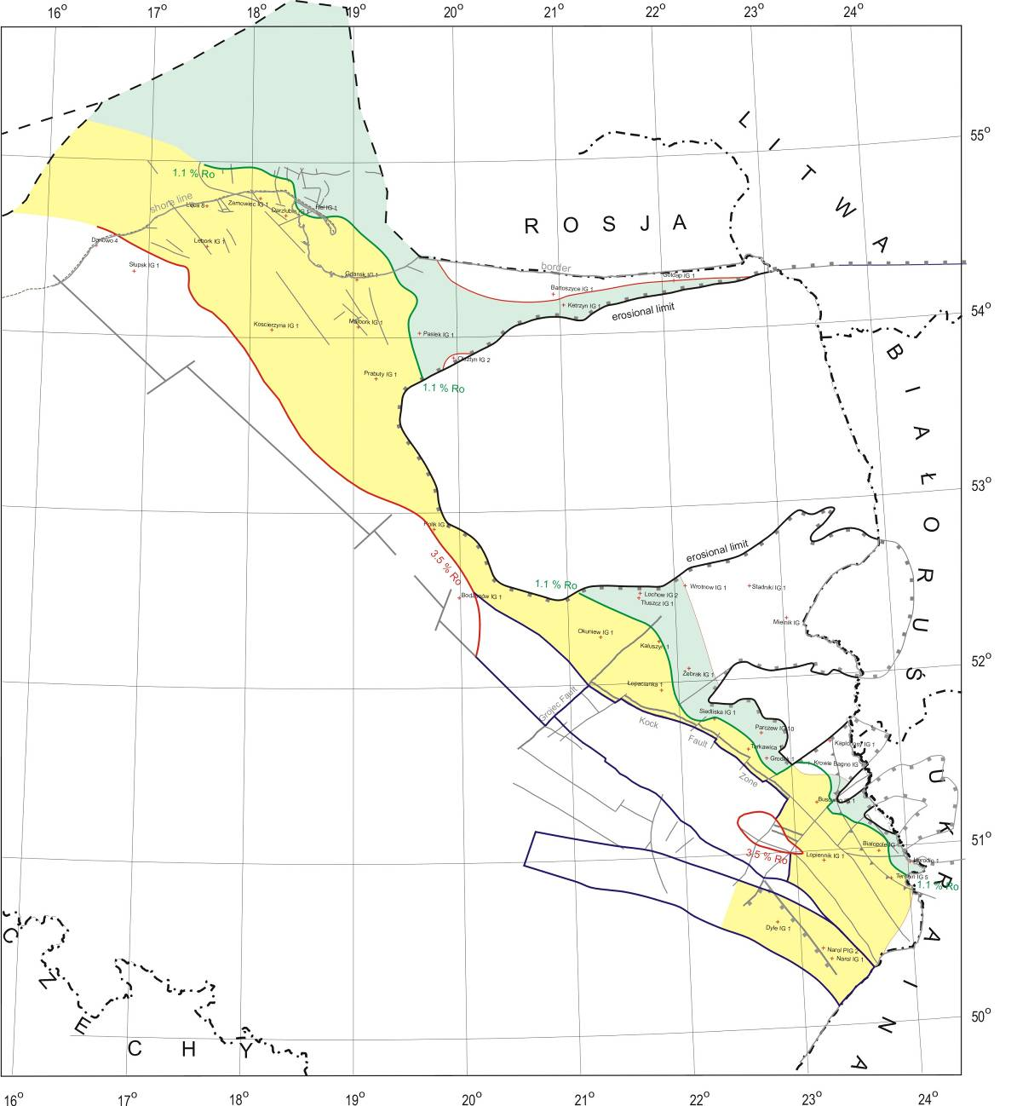
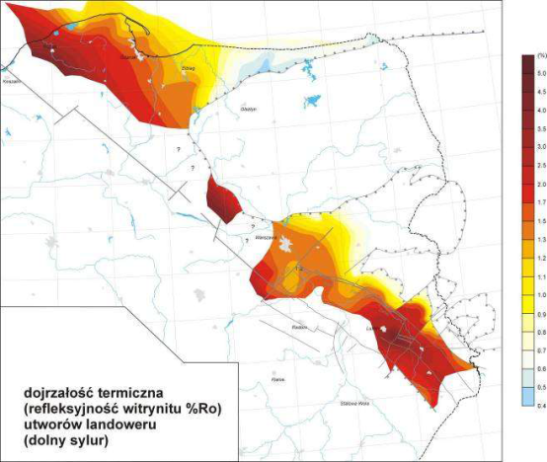
Going West for dry gas - with deeper burial, higher temperatures and pressures – however, the depth of target intervals is also increasing…
Lublin Basin
Batlic basin
Batlic basin
Oil prone
Gas prone
Maturity map
Lublin Basin

Slide 16
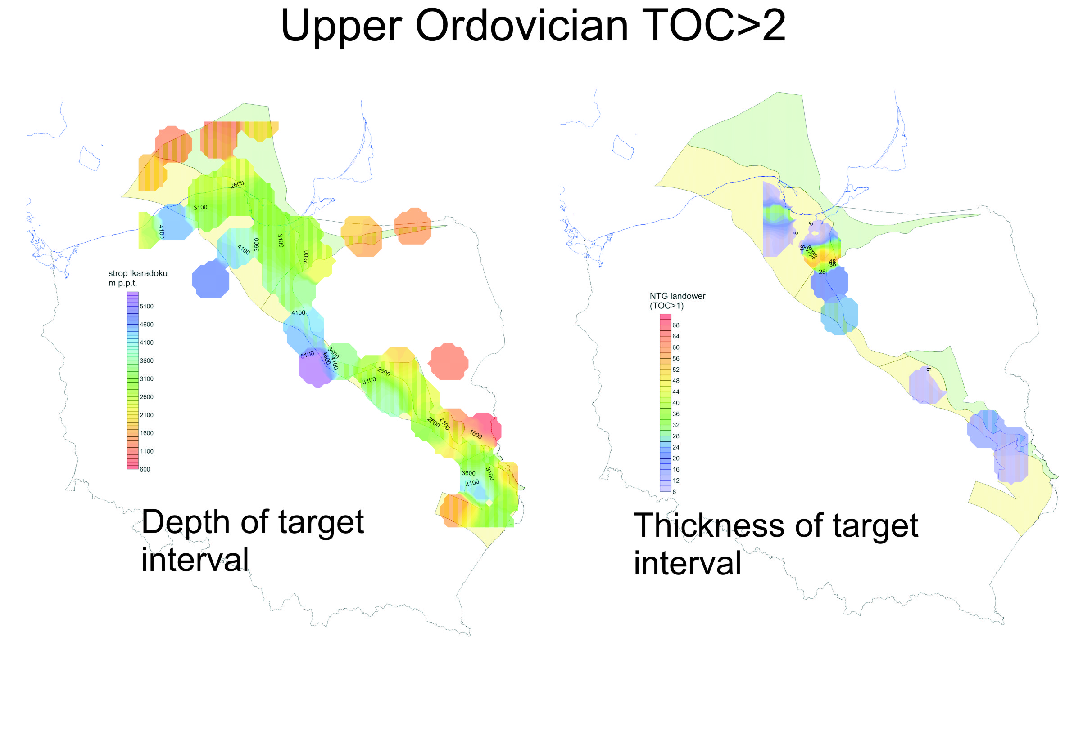
SCREENING OF AN ORDOVICIAN TARGET BASED ON EXISTING WELLS WITH A HIGHER AVERAGE ORGANIC MATTER (TOC) – HIGHER TOC ALONE IS NOT ENOUGH
1
Compiled by Adam Wójcicki
? offshore
Average
Good
IN EACH TARGET INTERVAL:
Thickness - potential volume of gas-in-place
+ Composition of bulk rock (carbonate, quartz, total clay) –
brittleness, susceptibility to hydraulic fracturing
+ Total organic carbon (TOC) – generation of hydrocarbons
____________________________________________________
= POTENTIAL SWEET SPOT (however, you have to be lucky to have all these delights occurring together in one place)
After all, the depth of potential sweet spot is also important – the deeper,
the higher the cost

Slide 17
A problem: high clay content
Smectite group of clay minerals is particularly unwanted, as these minerals swell in contact with water, clogging the fractures

Slide 18
HOW TO BREAK POLISH SHALES?

Slide 19
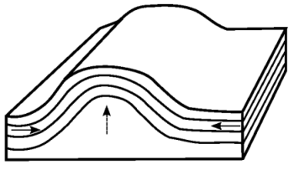
Prehaps, let’s find the spots where the Mother Nature did the job? In places, tectonized zones can be the most productive ones! A hint from China (Fuling field)
Naturally formed fractures
at the crest of anticline = hydrocarbon pathway to wellbore – enhancement of gas flow into the well
After: GUO Tonglou, ZHANG Hanrong

Slide 20
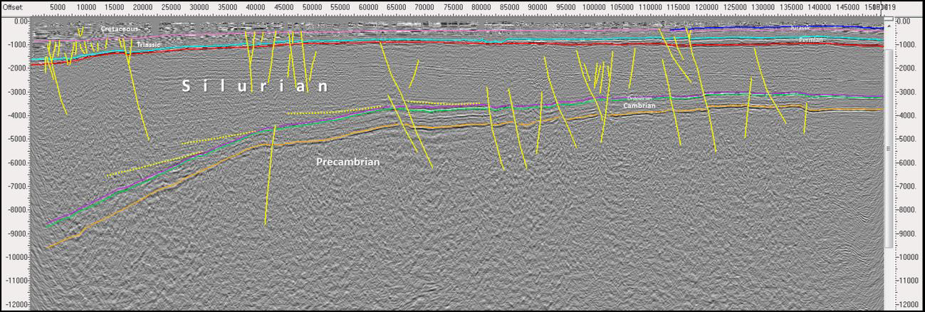
AT FIRST, VERY CAREFUL GEOLOGICAL RESEARCH
Regional seismic section, Baltic Basin, Silurian sequence and teconics (Krzywiec et al., 2013)
Diminishing thickness, less organic carbon, but more carbonate or silica content – better brittleness
Lublin Basin is more intensively tectonised – also Carboniferous may be attractive

Slide 21
More effective fracturing, adjusted to local geology - one fracturing linking two formations – chance to exploit at once separated gas-bearing intervals
(BNK Gapowo well)
10-
15 m
(too
thin)
Thin organic-rich shale, gas bearing interval
Jantar Mb.
Barren marlstones
Prabuty Fm.
well
10-
15 m
(too
thin)
Thin organic-rich shale, gas bearing interval
Sasino Fm.
This situation may be quite common in geological reality - application of this method needs a very high pecision in the well guidance and sometimes heavier hydraulical pressures applied. If separating rock represents non-permeable sandstone, combination of shale and tight gas may occur

Slide 22
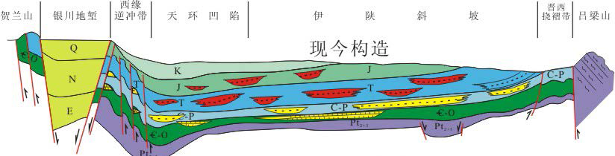
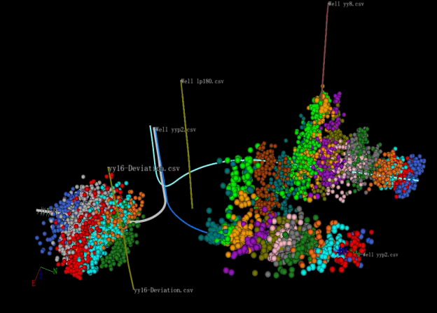
Breaking clay-rich shales - massive fracturing (example from China)
Ordos Basin, Gao Ruimin, Yanchang Petroleum
Liquid CO2 fracturing? Is it real solution for clayey shales?
However, it is likely that the applicable technologies have already been captured, and the possible innovations will not bring dramatic progress

Slide 23
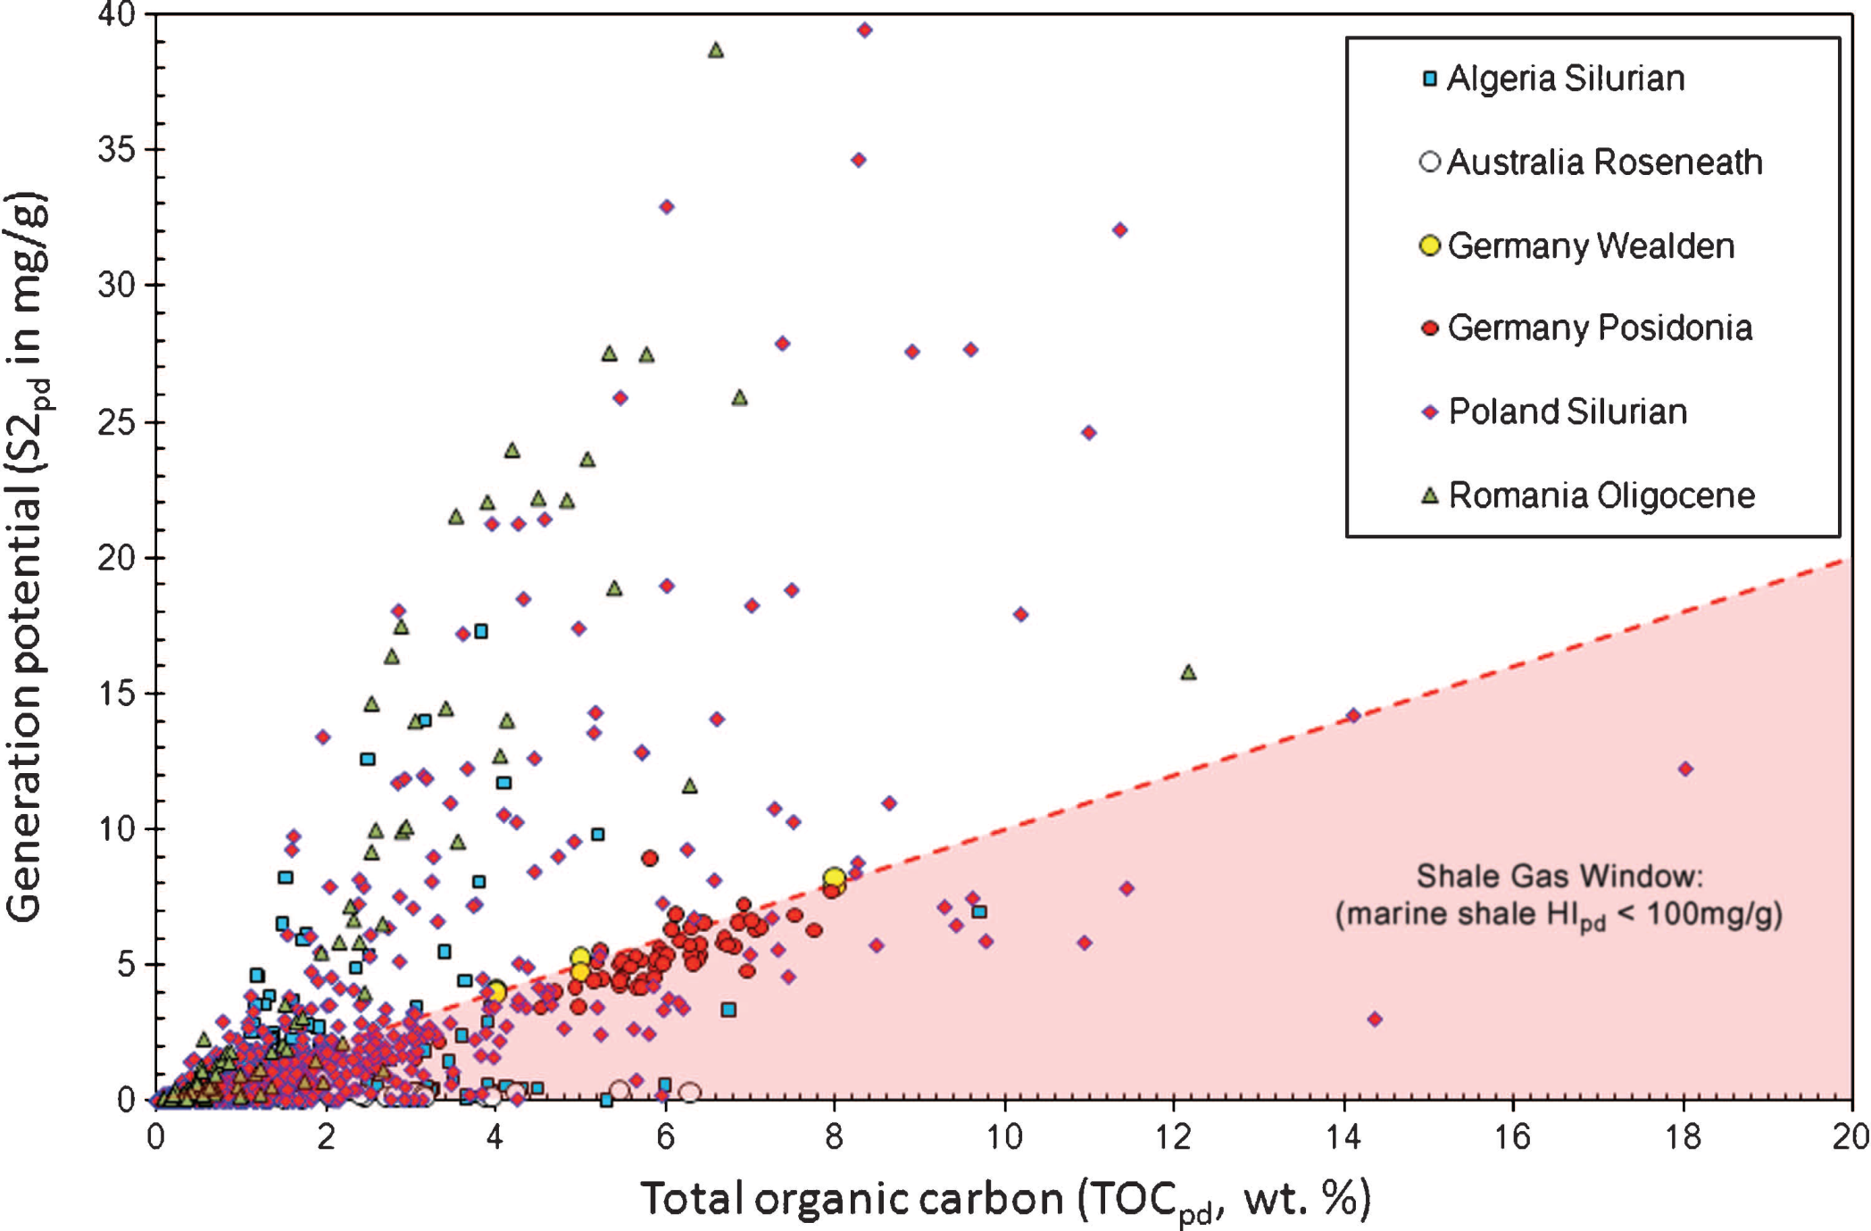
Polish Silurian shales represents a wide spectrum - other shales in Europe are within this spectrum (after D. Jarvie, 2012)
Polish Silurian
German Lower Jurassic

Slide 24
We expect that shale play geology in Poland will be similar to other European basins
Hydrocarbons in the Paleozoic basins of Central Europe were commonly generated during Variscan time, rising uncertainty
as for gas retention
Thermal maturity often is not high enough for dry gas, and considerable parts of the analyzed basins might have liquids
and oil potential
European Paleozoic basins with shale gas/oil potential are often tectonically deformed, causing technological challenges - but in some places tectonical deformations can help
In Poland (and elsewhere in Europe) thickness of TOC rich layer
(and net pay) is often low
In Poland (and often in other basins) clay mineral content is relatively high, while brittle mineral content is low

Slide 25
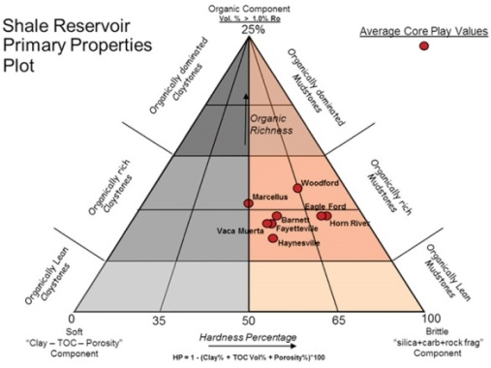
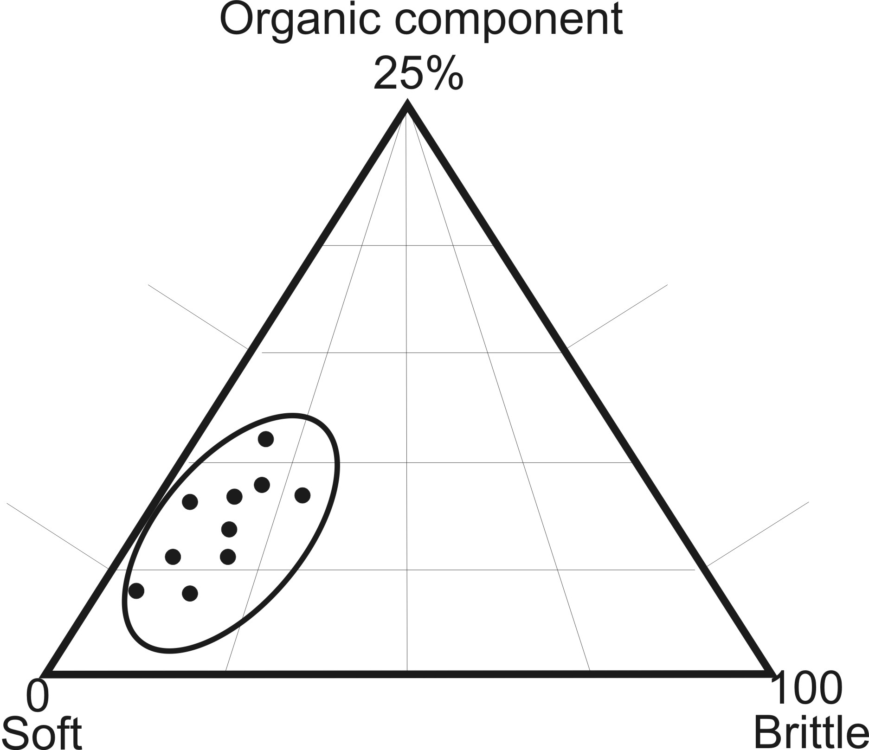
North America vs Poland – and Europe – note the sheer scale of American basins and shale reservoir properties
Polish Basin
Main American basins

Slide 26
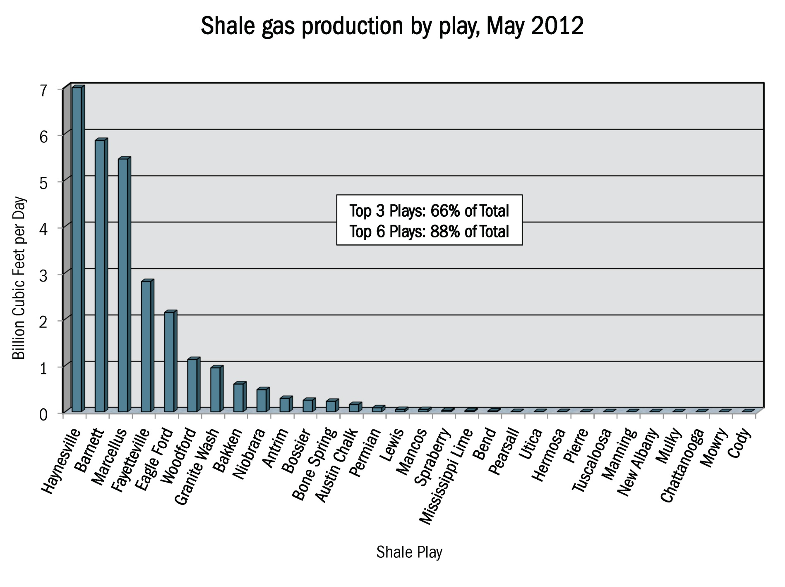



Productivity - American success, European reality
Top 3 plays
= 66%
A range to be expected in Polish (and European) basins?

Slide 27
WHAT ABOUT OTHER UNCONVENTIONAL RESOURCES?

Slide 28
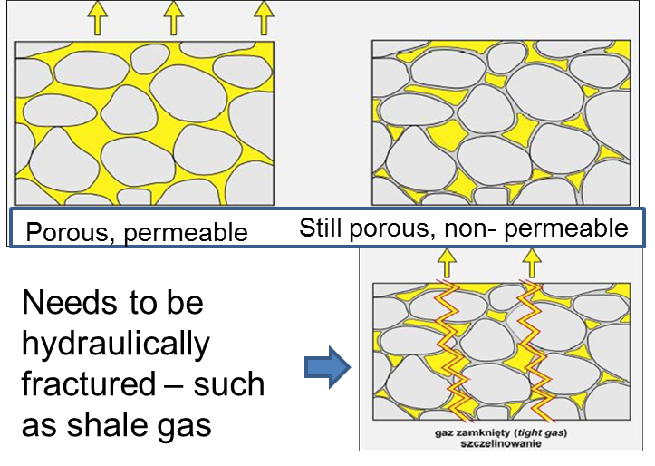
OTHER UNCONVENTIONAL HYDROCARBONS IN POLAND – TIGHT GAS
CONVENTIONAL
TIGHT GAS
Tight gas
Coal Bed Methane

Slide 29
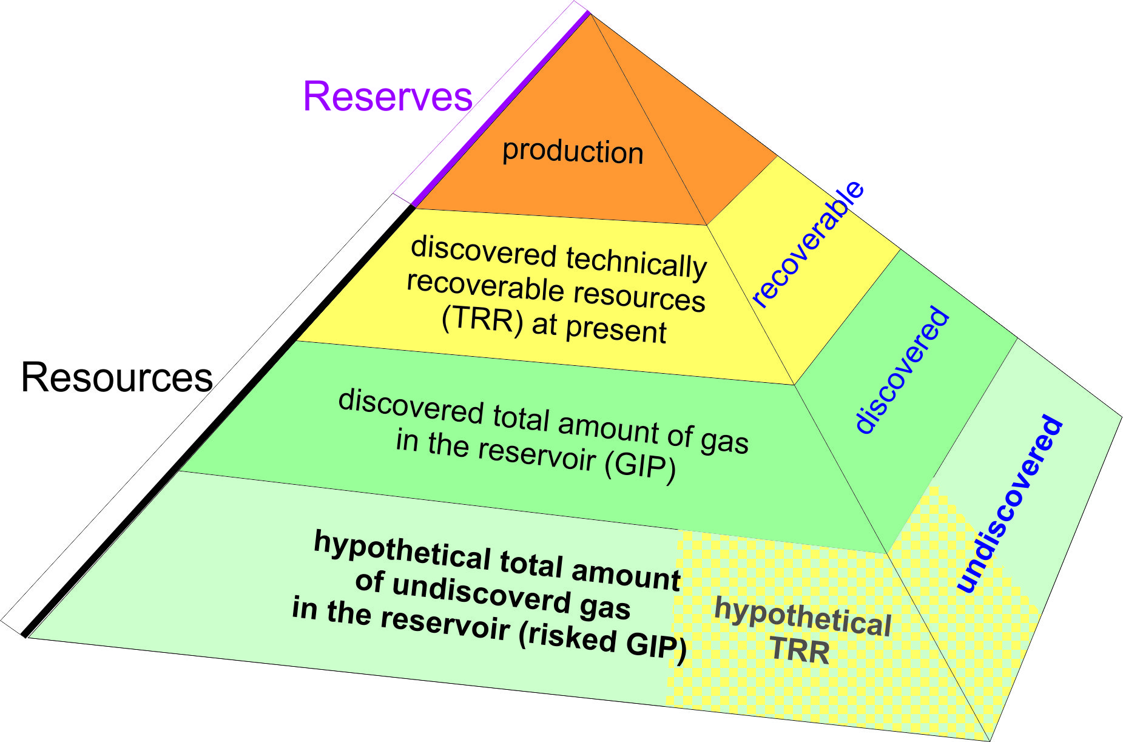
Tight gas, Poland: undiscovered (risked) GIP values for the reservoir formations of Rotliegend, Carboniferous and Cambrian; given in Tcf.
Reservoir formation | Depth [m] b.s.l. | Minimum [Tcf] | Best estimate [Tcf] | Maximum [Tcf]
I – Permian (Rotliegend) sandstones | 5500-6000 or 5100-6000 | 3.57 or 7.62 | 12.18 or 28.66 | 31.21 or 81.47
II – Carboniferous sandstones | 1800-3500 | 15.99 | 40.22 | 99.62
III – Cambrian sandstones | 2800-3100 | 0.60 | 1.34 | 2.82
TOTAL | - | 20.16÷24.22 | 53.94÷70.42 | 133.65÷183.91

Slide 30
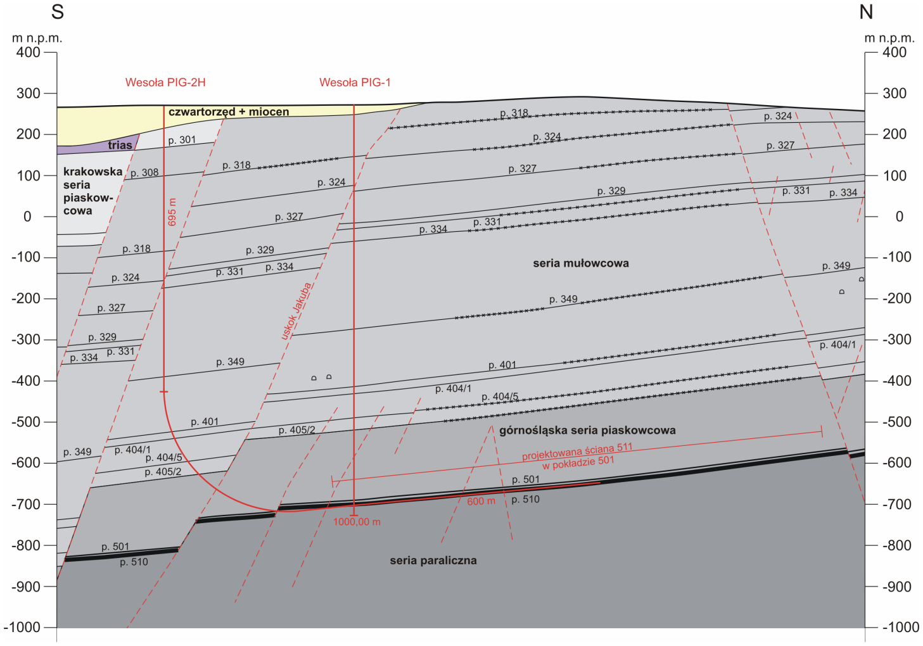
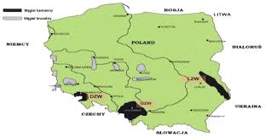
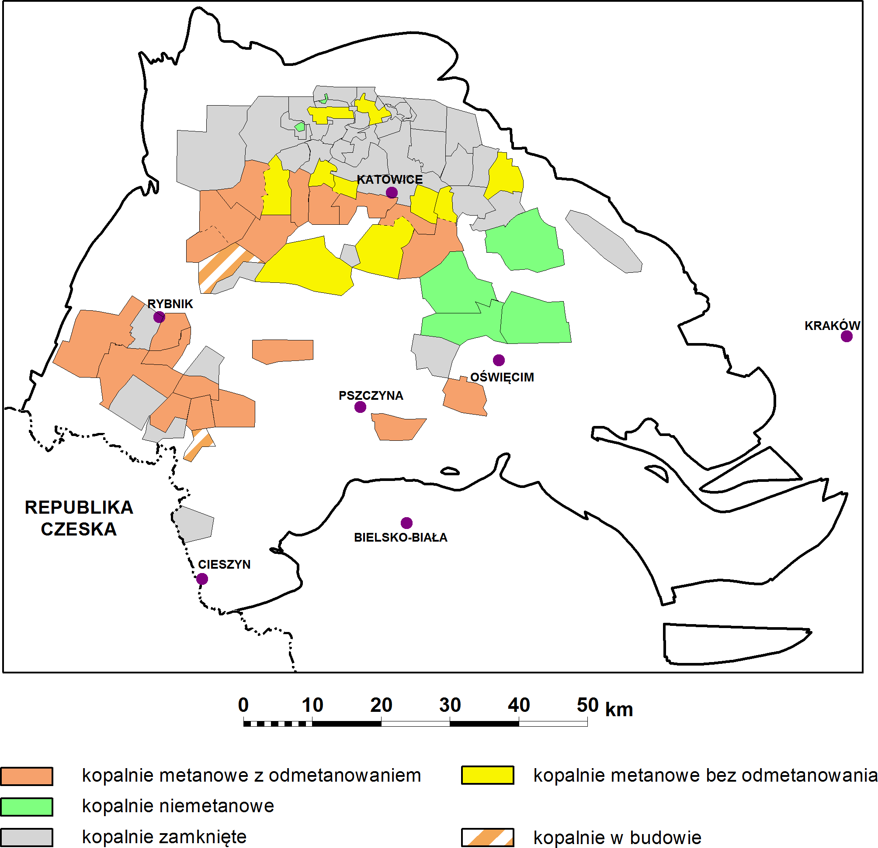
CBM (Coal Bed Methane) – the first coal hydraulic fracturing operation in a working coal mine (Wesoła, Poland)
600 m horizontal section with hydraulic fracturing
Recoverable resources in Poland – c. 170 billion m³ (bcm)
Current emission of CH₄ – 660 million m³/year, 190 million m³ – captured
Safety – 64 casualties since 2000
Climate impact - 660 million m³ of CH₄ = approximately 15,5 billion m³ of CO₂

Slide 31
CONCLUSIVE
REMARKS

Slide 32
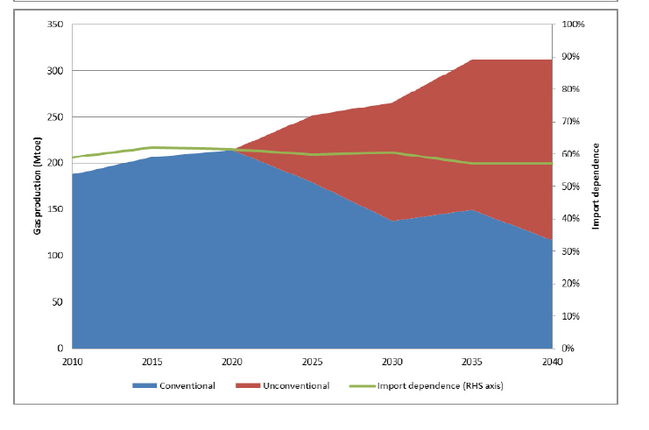

Unconventional Gas: Potential Energy Market Impacts in the European Union, JRC Scientific and Policy Reports, 2012
OPTIMISTIC SCENARIO
IMPORT DEPENDENCE STABLE
UNCONVENTIONAL GAS
Million tonnes of oil equivalent

Slide 33
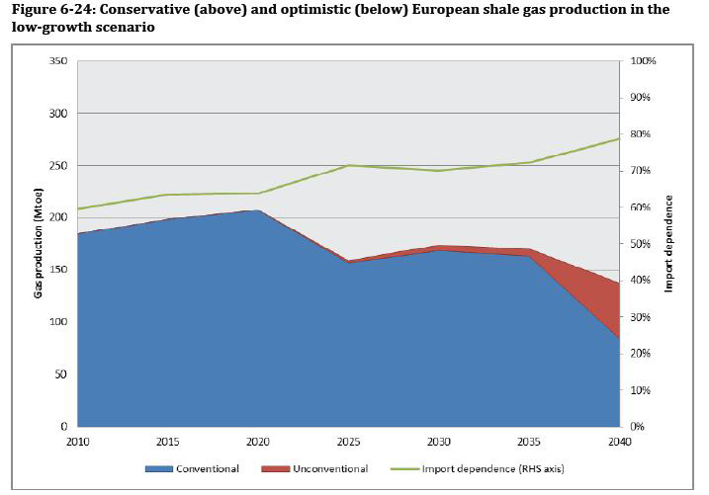
Unconventional Gas: Potential Energy Market Impacts in the European Union, JRC Scientific and Policy Reports, 2012
PESSIMISTIC SCENARIO
GROWING IMPORT DEPENDENCE
UNCONVENTIONAL GAS
Million tonnes of oil equivalent
CONVENTIONAL GAS
In both scenarios Europe needs shale gas production or gas high import, possible partly from Canada or US

Slide 34
Final conclusions:
EU is still in early exploration phase. Poland and currently England are the only two countries in Europe having scenario of possible economic growth, based on shale gas production. We cannot simply adapt neither U.S. (exceptionally good geological conditions, different regulatory framework, environmental issues), nor (subsidised) Chinese shale gas exploration experiences, as a model for Europe (although, in terms of geology China is more compatible).
HOWEVER:
Today’s pessimism about shale gas in Poland reflects (in a reversed sense) the early frenzy
- and is just as overblown
Currently, we can map more accurately early commercial potential of the Polish shales, there is also
a progress in gas output results, so we are on a learning curve. There is still no substitute for ‘learning-by-doing’, i.e. the knowledge that comes from drilling and completing wells.
Higher amounts of condensate/oil than anticipated, whereas natural gas production is lower than
had been hoped. Importantly, wet gas (higher content of natural gas liquids) is economically attractive
Forget about 150 bcm/year – as originally hoped for. But even 5 bcm/year might be important (it would be a 1/3 of current annual consumption in Poland). Tight gas and CBM can provide additional production, and conventional accumulations can be associated with unconventional plays. Many hitherto reports are strongly oriented to think in a way of production from conventional gas reserves –
which is a misleading approach. In a sense, Polish experience can serve as a huge demonstration project for the rest of Europe
Notes:
Zaprojektowane badania pozwoliły ocenić rzeczywisty wpływ działalności związanej z poszukiwaniem i rozpoznawaniem gazu z łupków na środowisko naturalne.
Nie stwierdzono zanieczyszczeń wód podziemnych o charakterze przestrzennym wynikających z działalności zakładów wykonujących roboty geologiczne polegające na poszukiwaniu i rozpoznawaniu niekonwencjonalnych złóż węglowodorów metodą otworową.
34

